Slide 1
Cross Training & Intro Template
Consider having one member of your team do this each month. Then repeat: yearly, whenever there is staff turnover, or when your discipline has revisions in role or practices.
- FTC Best Practice 1, Provision G.
My Job title on a Family Therapeutic Court Team
My Role, My Expertise,
&My Why

Slide 2
Cross-Training & Intro to Meghan
To demonstrate a suggested use for this template I’ve filled this in using my experience as a volunteer guardian ad Litem in Whatcom County and CASA in Yakima County. The actual role of a vGAL/CASA in your county and in your team may be slightly different . Try to be open to conversations about how to best support your court within your ethical responsibilities.
Volunteer Guardian ad Litem
My Role, My Expertise,
&My Why

Slide 3
Call me _____ (pronouns if comfortable)
I prefer communication by ____, ____ then as a last resort by _____
Role

Slide 4
Call me Meghan (Dr. Fitzgerald if you’re feeling formal) I use she/her/hers pronouns
I prefer communication by email or text or carrier pigeon, then as a last resort by phone call
Volunteer GAL

Slide 5
I am a (noun, role in work/life)
Think of this section as the basic info you might tell someone you just met in your job, other folks may have heard it before, but memories are short.
I’ve worked in this field ___ years & this position for ___ years
I have a degree in _____
I have lived expertise in _____
I have extra knowledge in _____
I am really interested & excited about work with ________
Role

Slide 6
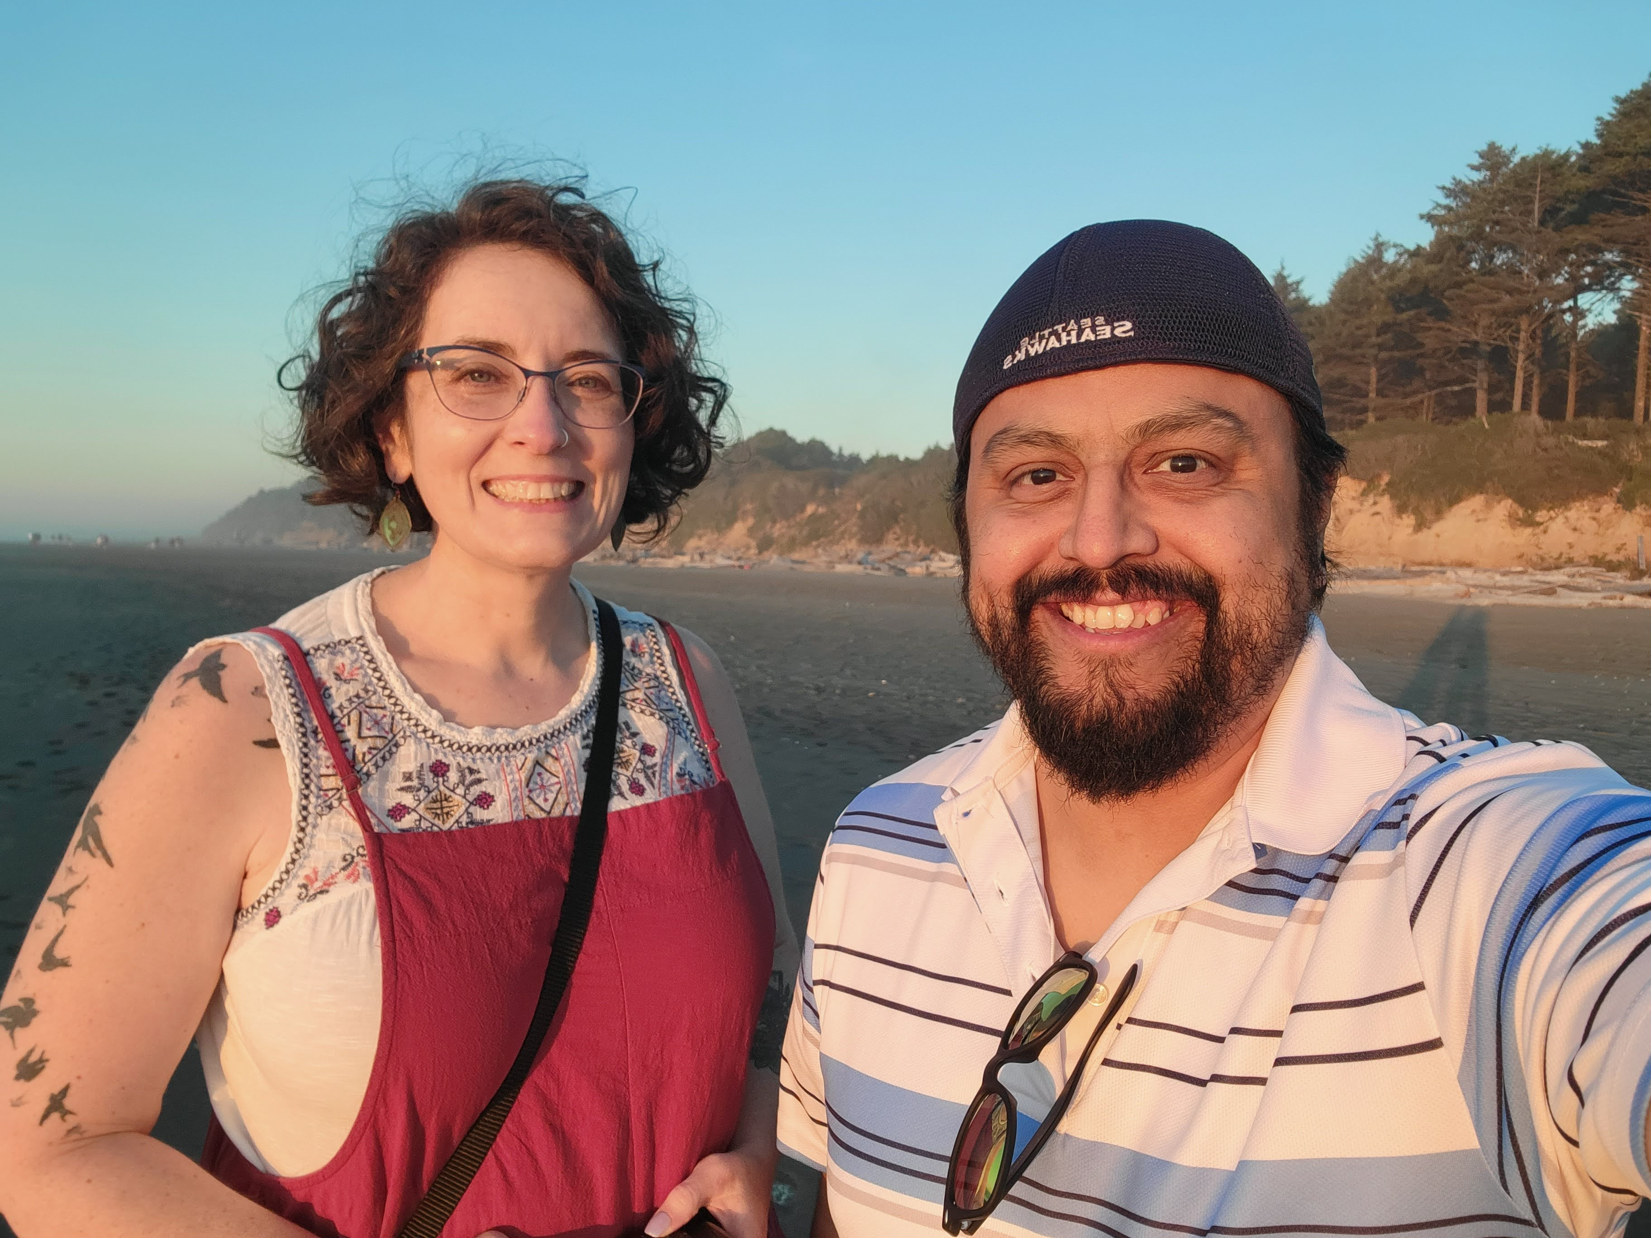
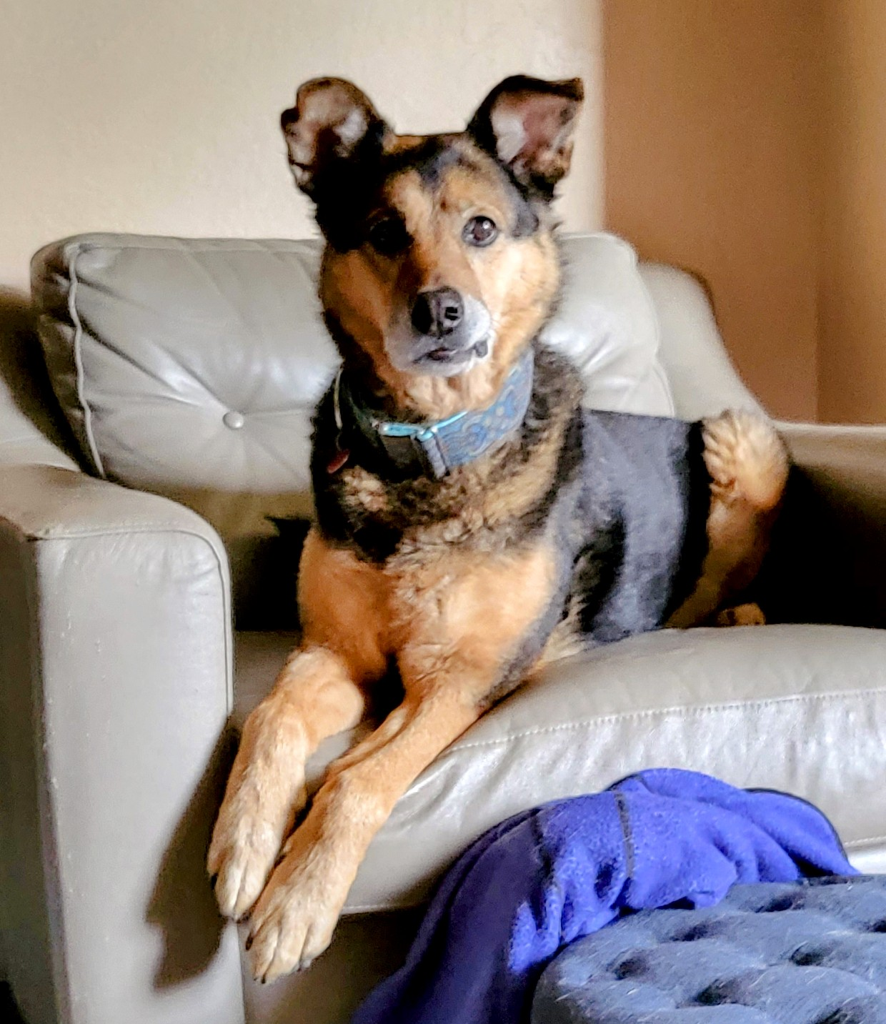
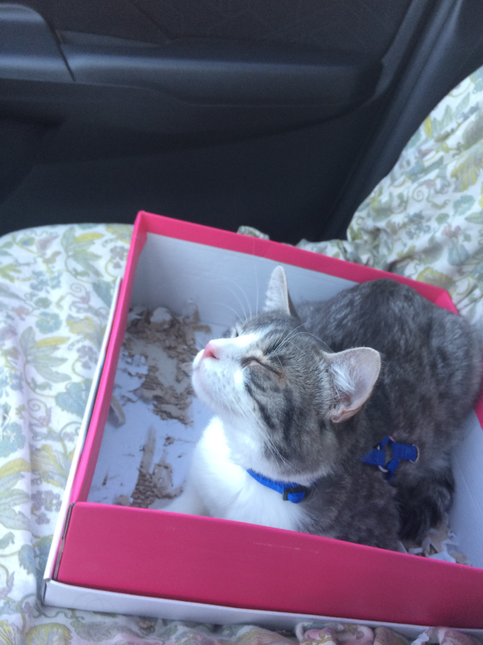
I am a Community Member, a sister, an Auntie, a survivor, an Educator, A Therapist, and A Middle Child
I love helping people to meet their goals and the way I do this best is through teaching, bringing people together for conversations, and by listening and reflecting. .
I’ve worked in the education field for 12 years & volunteered as a GAL/CASA since 2017
I have a degree in Zoology/Animal Behavior/Spiders (PhD) and almost in Mental Health Counseling (MA)
I have lived expertise in overcoming childhood abuse & trauma
I have extra knowledge in accessibility
I am really interested & excited about work with equity, inclusion, belonging, identity
Volunteer GAL

Slide 7
I see my role as:
You may want to break this up into multiple slides/topics
REQUIREMENTS: What does your job description say? What are you required to do based on your contract, ethical code, MOU or professional guidelines.
Goal: to help team members to see what you have to do, and know who to ask if they need specific info or expertise.
How often are you in contact with the participants?
Day to day activities that your job entails
What ethical guidelines are you required to meet/exceed FOR THIS TEAM (general info to follow)?
What is your agreement with the FTC team as you see it?
How often do you have to report? What info do you report?
WHAT IS SPECIAL/UNIQUE ABOUT YOUR ROLE?
As a _______ on this team I bring expertise in _______
What’s your elevator pitch? As a parent attorney, I am the only person who can __________ and I need information about _________ to do that well. Remember that your team is multidisciplinary, explain in clear and simple terms to someone outside of your field.
Role

Slide 8
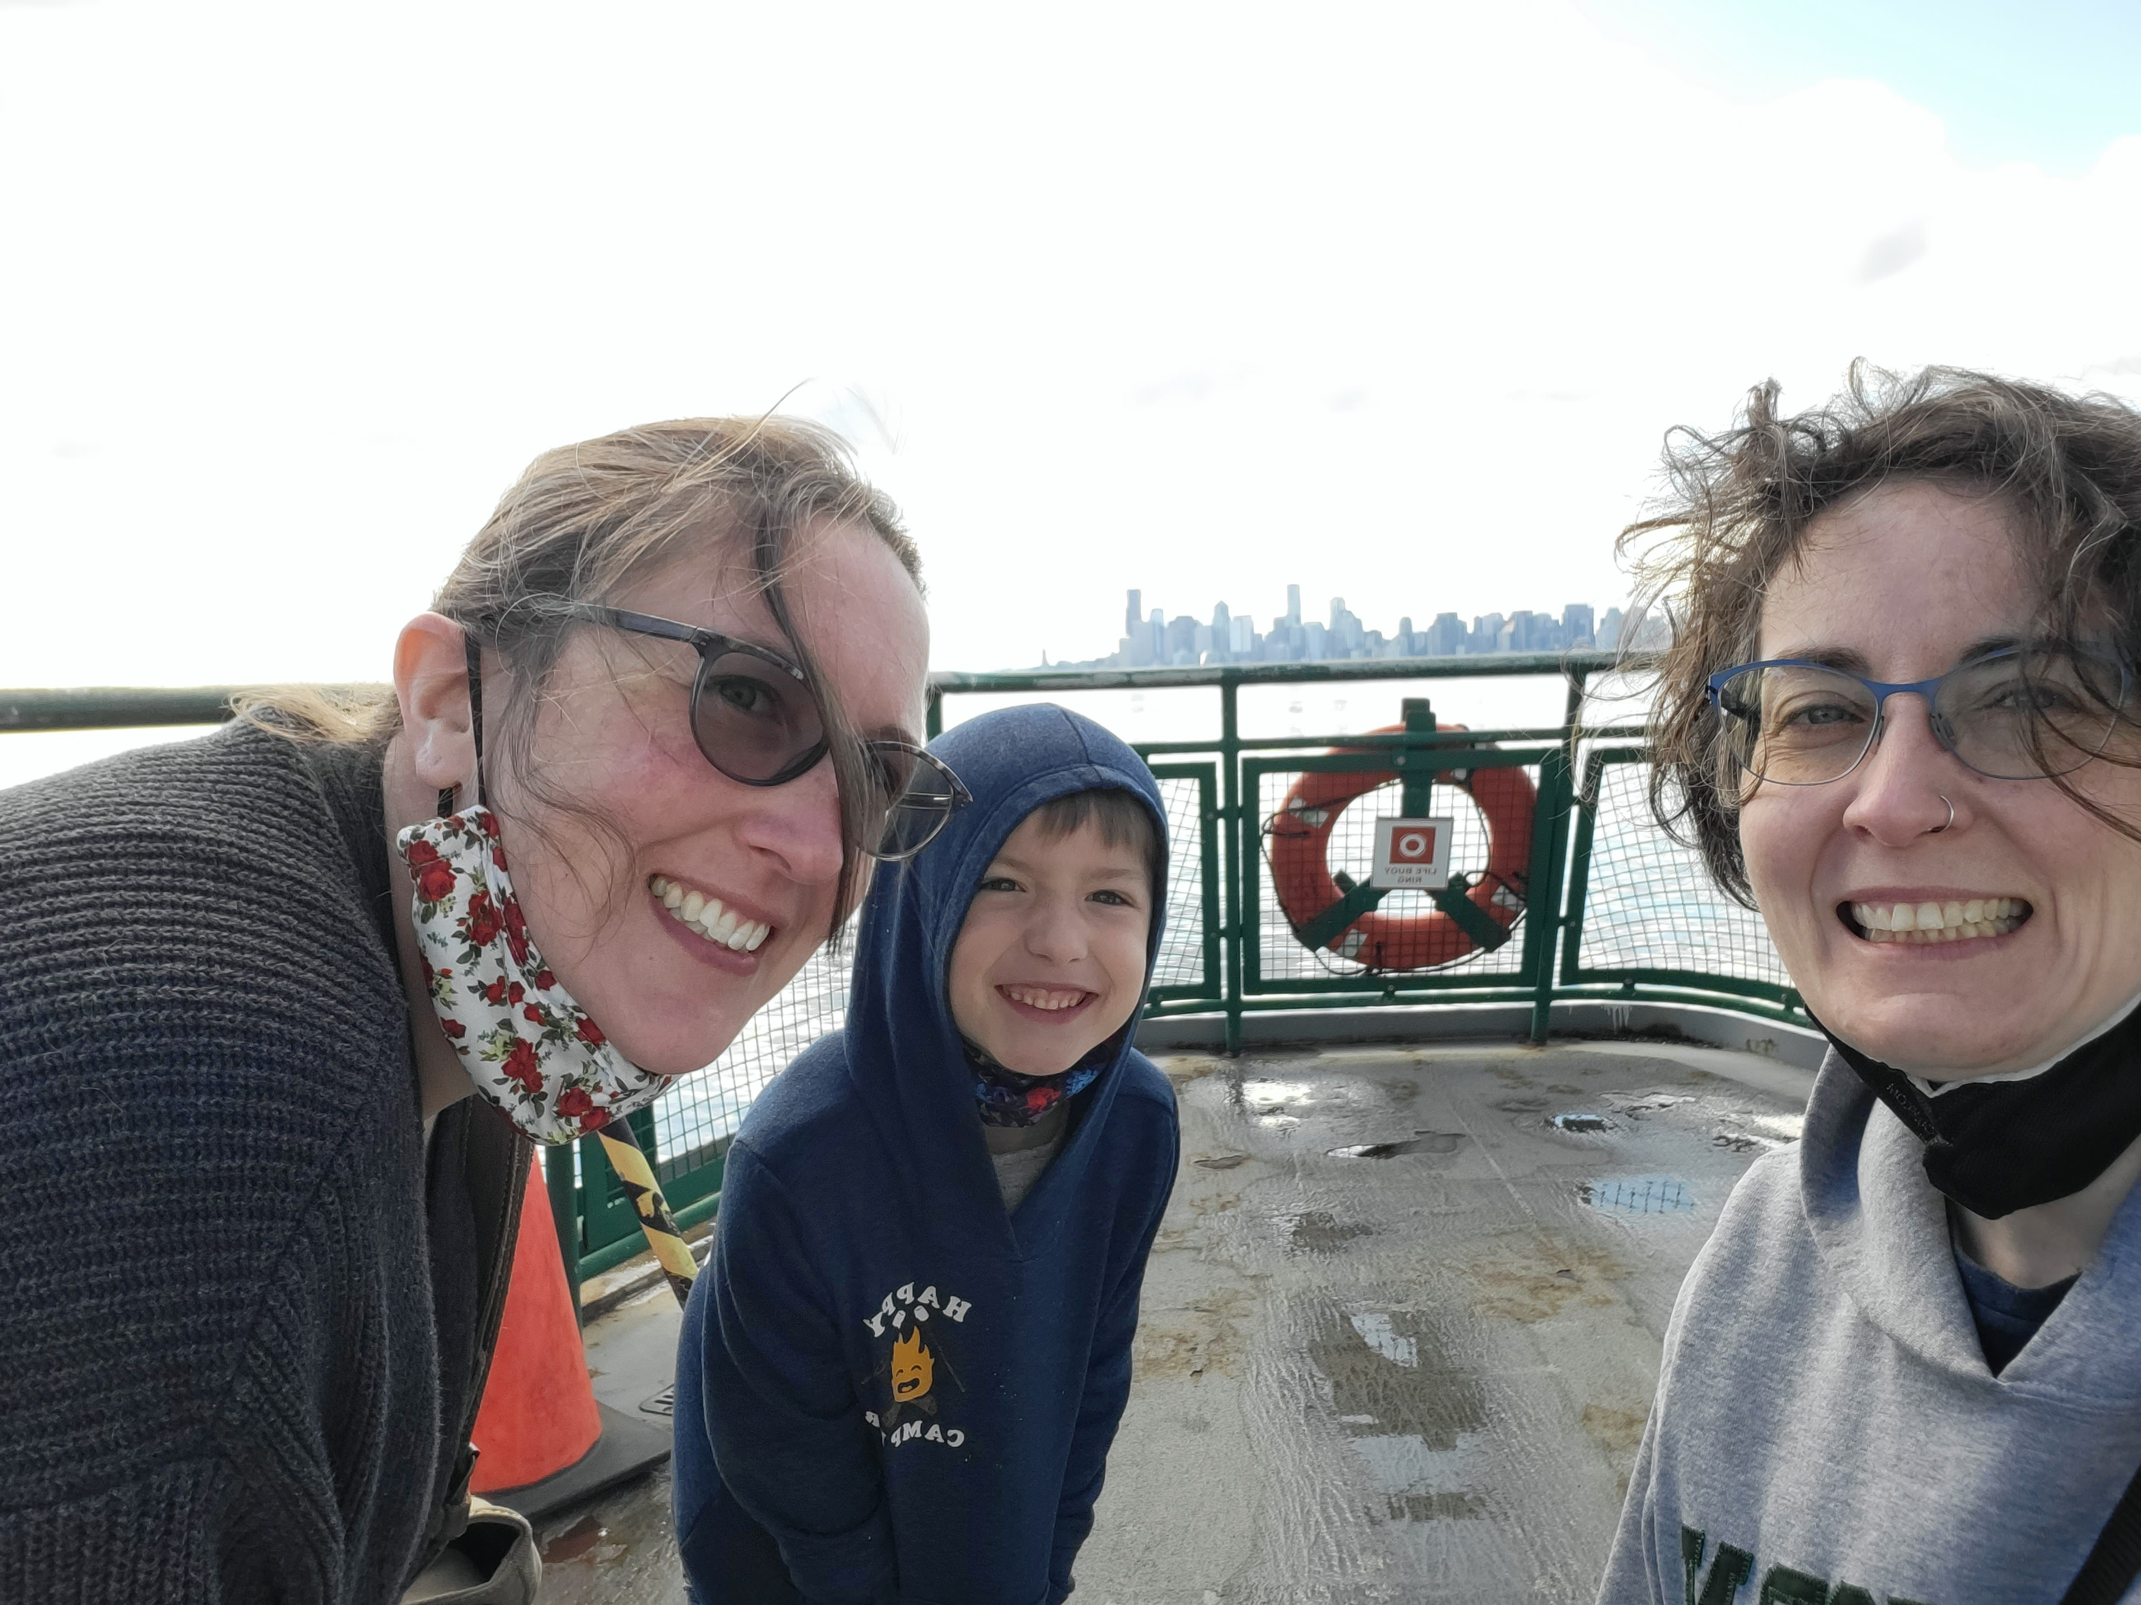
as a GAL on this ftc team
Most important to me is regularly keeping up with any kids I’m assigned to and make sure they are feeling safe, getting their needs met, and heading towards a solid plan of permanency.
REQUIREMENTS :
Follow the agreement I signed with the court
Visit the child at least one time per month
Try to visit all other parties about an equal # of times
Call social worker and teachers regularly (try for monthly)
Go to all meetings at court and school regarding kids
Build connections where possible.
Share only general expertise to non-parties to the case
For example, I might say, I can’t speak to your case, but I would recommend you call your attorney to talk about that.
Or I might say, typically we have an FTDM every ___ months, but if there is something pressing, you should ask your social worker and attorney to schedule one.
Volunteer GAL

Slide 9
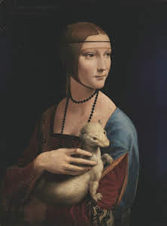
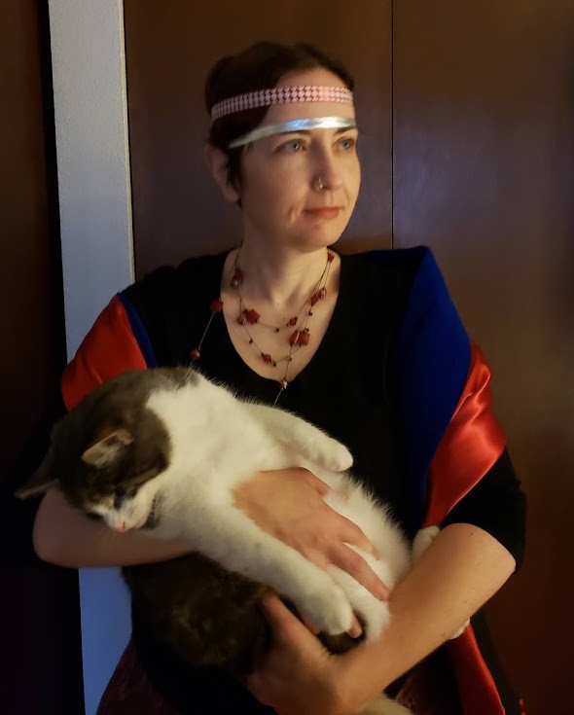
as a GAL on this ftc team (PART 2)
My most important role is to regularly keep up with any kids I’m assigned to and make sure they are feeling safe, getting their needs met, and heading towards a solid plan of permanency.
WHAT IS SPECIAL/UNIQUE ABOUT YOUR ROLE?
A GAL generally gets more freedom to choose how many clients they take on, so I’m more flexible in communication and checking in
I’m a child advocate, but also have been trained in how important family, particularly biological family, is to helping a child grow into a mentally, emotionally, and physically healthy adult, so being a family advocate is equally important.
This means I am sometimes asking for more visits to maintain relationships, and sometimes asking folks to make sure this kid can make it to soccer practice even though it on visit days. I’m also often the only one who knows about soccer practice.
Oh wait – can we have Mom and Dad come to soccer practice? Even better!
Lady with an ermine (left) Meghan with a cat (right) Re-enactment
Volunteer GAL

Slide 10
How can we help each other?
PERSONAL STRENGTHS AND STRUGGLES:
What are you able to do well in current team?
What do you struggle with?
Is there anything you wish the team knew about you that might help them to remove stigma from your position?
Role

Slide 11
How can we help each other?
PERSONAL STRENGTHS AND STRUGGLES:
I am good at communicating regularly and keeping all people involved
I am not good at report deadlines (but I try really hard!)
I struggle with full time work while volunteering, but mostly feel supported if I can’t make it to a meeting and make sure to only take on one case at a time.
I would love if we had a more detailed MOU for my position and some examples of reports so I can make sure I’m getting that info right
Volunteer GAL

Slide 12
Slide Title
My ethical Obligations
Use this section to talk more generally about your job to folks from other fields. If you were at a high school career fair, how would you describe your role and the ethical obligations of that job?
.
I am a member of ____ Association that decides on the legal and ethical obligations of my position
The basic rules I follow are:
Mention: Privacy, standards of care, Anything a non-lawyer, non-judge, non-SUD provider would need to know
.
Role

Slide 13
Slide Title
My ethical Obligations
According to the National CASA/GAL Association for Children:
“volunteers advocate for the best-interests of children who have experienced abuse or neglect. Volunteers work with child welfare professionals, educators and service providers to ensure that judges have the information they need to make the most well-informed decisions for each child”
The basic rules I follow are:
I don’t give legal advice
I do make connections between partners and needs
I do report facts and information
Separately I give my opinion of best interests.
Volunteer GAL

Slide 14
Suggestion
Consider pausing here for a team conversation about questions, anything that might need to change, anything that is not mentioned that should be. Consider coming to an agreement as a team about what the role should look like. Then spend a little time documenting that as an MOU or in a provider manual

Slide 15
A hypothetical
What would be my role in this situation?
7 year old female child
In out of home care for 6 months
Primary safety risk at removal was drug paraphernalia and witnessing DV against mother by paramour
Unstable housing
Unknown father
Mother
has never missed a visit
has not entered treatment or maintained sobriety from drug of choice: methamphetamine
Recently, child told GAL she was “afraid of Mom” during unsupervised visits.
Resource parents report tantrums and behavioral issues after every visit.
Role

Slide 16
A hypothetical
What would be my role in this situation?
7 year old female child
What I might do as a GAL
In out of home care for 6 months
Primary safety risk at removal was drug paraphernalia and witnessing DV against mother by paramour
Unstable housing
Unknown father
Mother
has never missed a visit
has not entered treatment or maintained sobriety from drug of choice: methamphetamine
Recently, child told GAL she was “afraid of Mom” during unsupervised visits.
Resource parents report tantrums and behavioral issues after every visit.
My role to work with other professionals
Try to talk with as many people as I am able and connect to each other if possible –
My motto is: “the more people that love this kid the better.”
My role as an information gatherer:
Visit child + parties to case monthly, report for each hearing
Try to determine what “afraid of Mom” means and report to court + opinion
Ask child (gently, simply, without coercion and with acknowledgement of trauma), “Can you tell me more about that?”
Ask Mom, “has anything happened in visits that might be impacting child?”
Ask therapist, social worker, etc about child’s anxiety, safety worries. Check with therapist if tantrums/behavioral issues/fears seem outside of typical expectations for foster child of this age
Volunteer GAL

Slide 17
A hypothetical
What would be my role in this situation?
7 year old female child
What I might do as a GAL
In out of home care for 6 months
Primary safety risk at removal was drug paraphernalia and witnessing DV against mother by paramour
Unstable housing
Unknown father
Mother
has never missed a visit
has not entered treatment or maintained sobriety from drug of choice: methamphetamine
Recently, child told GAL she was “afraid of Mom” during unsupervised visits.
Resource parents report tantrums and behavioral issues after every visit.
My role as advocate for this child:
Check in with social worker, find out if anyone is concerned about safety risks in visits.
Check in with teachers: How is school?
Consider that visits are what is best for child, even when hard (research supports this), so how can I advocate to make them less scary.
Ask to attend visit if child would like you there. Let Mom know that you’d love to see the great work she’s doing.
Strongly advocate for child counseling if not already in therapy – add to report. Talk to therapist about child’s fear if already in therapy. Advocate for attachment therapy.
Recommend support for resource parents (child is missing Mom and has experienced changes, but tantrums are hard – do they have family therapy? Respite? Training in development? Support from agency?
Keeping stable temporary home for child is also in child’s best interest – how can we avoid disruption?
Volunteer GAL

Slide 18
SUggestion
Your team may be tempted to change up the scenarios, but it also important to work on one and see it from different roles. You could consider doing a scenario together in a team meeting, and have each person describe the role of their own position, or of another position. This will help to clarify misunderstandings.

Slide 19
Something I want to work on
This could be anything you’d like the team to do/know/work towards

Slide 20
I recently learned
More about the history of ICWA and what it means to have “Active Efforts” in a case.
I’d love to talk about this more!

Slide 21
THANK YOU
Name
+1 23 987 6554
april@courts.wa.gov
http://wacita.org

Slide 22
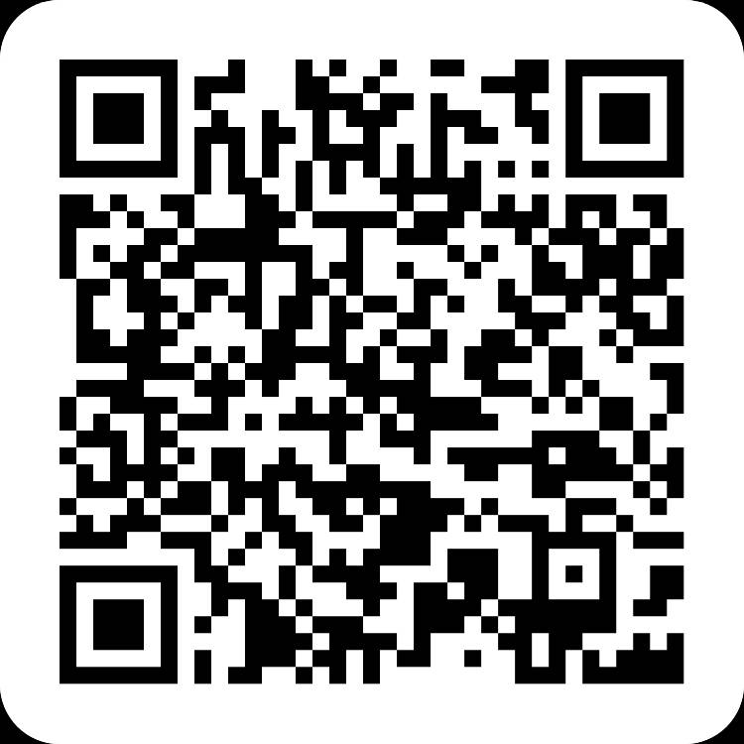
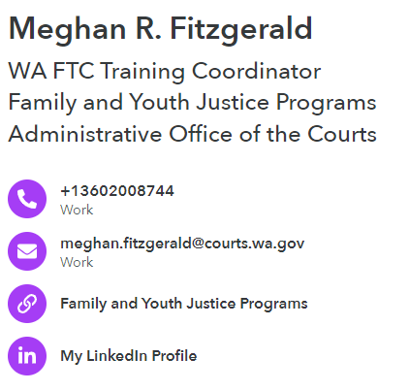
THANK YOU
This QR code will let you direct download my contact info

