Slide 1
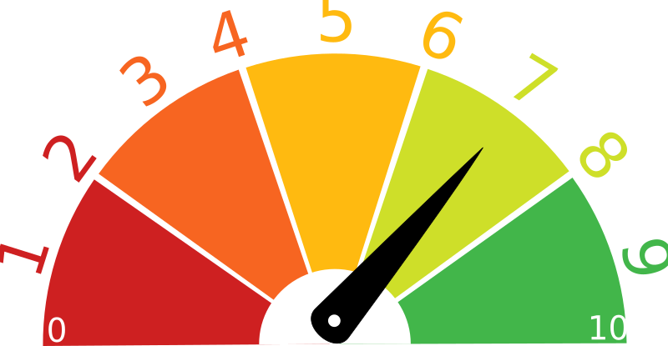

Monitoring & Evaluation
Best Practice 8 for Family Treatment Courts

Slide 2





Funding and Partners Acknowledgement
This project is supported by Grant # 2020-AR-BX-K001 awarded by the Office of Juvenile Justice and Delinquency Prevention, Office of Justice Programs, U.S. Department of Justice. The opinions, findings, and conclusions or recommendations expressed in this publication/program/exhibition are those of the author(s) and do not necessarily reflect those of the Department of Justice or our partner organizations.

Slide 3




FTC Best Practice 8:
Monitoring and Evaluation
Engage in a Process of Continuous Quality Improvement (CQI)
Maintain Data Electronically
Evaluate Adherence to Best Practice
Use Rigorous Evaluation Methods

Slide 4


Provision A: Maintain Data Electronically
FTCs in WA
20 family treatment courts in 19 counties
2 Family Healing to Wellness Courts.
Currently Using an Electronic Data Management System
59%
13/22 of WA Family-Focused Treatment Courts are Maintaining Records using DCCM, Connexis, or some other data management software

Slide 5


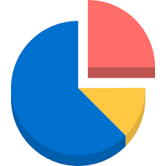
Why Electronic Records?
Ease of Use
Change Management
Evidence-Based
Heritability of knowledge to future teams
Simple Reporting to grant holders, fundraisers, and stakeholders
Standardization of data allows comparison, research, and identification of areas to improve
An Adult Drug Court review found:
Courts with Electronic Records and CQI had higher graduation rates
Courts using paper records had high investment costs and lower graduation rates
(NPC Research, 2008 review)
Electronic Records:
Increase a courts ability to make modifications & track changes to meet the team’s goals.

Slide 6

Data Entry
Very few people enjoy data entry, but . . .

Slide 7

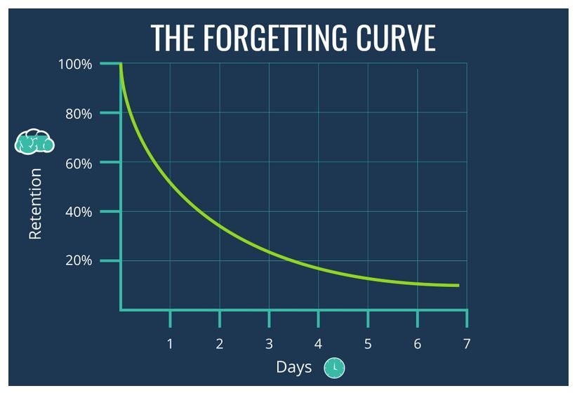
Entering Data Immediately
Entering data immediately leads to less mistakes.
After 48 hours recall is less than 50%
After one week most of the detail is lost

Slide 8

Provision B:
Engage in a Process of Continuous Quality Improvement

Slide 9





CQI
Intentional
Using a careful planning process courts can evaluate where changes will make the greatest impact
CQI
Continuous
Quality
Improvement
Gradual
Change takes time! Small improvements that are carefully monitored lead to proven success over time
Tracking Progress
Data driven changes improve outcomes and allow us to show stakeholders our successes

Slide 10
Change Management – A CQI Method
Identify and Assess Needs & Opportunities
Develop a Theory of Change
Select or Design an Intervention
Plan, Prepare, & Implement
Evaluate and Apply Findings
Start again using what you’ve learned!
Using available data, decide as a team to make a change
Determine the Root Cause and develop needs assessment
Using available resources and a diverse team, design your process
Consider equity, timelines, and how you collect data for comparison in the future
Using your plan of action, test to see if the change was effective, if there were barriers to success, and if it should continue.

Slide 11

a sample of this process
Our team has put together a sample of this process
We would also be happy to set up a meeting to guide you through the steps as a team, and help you evaluate where a change might be most effective.
Go to our website to read more
Make an appointment

Slide 12





Consider CQI and Self-Evaluation Opportunities for Growth

Slide 13

Provision C. Evaluate Adherence to Best Practices
Provision C.
        Evaluate Adherence to Best Practices
The Family Treatment Court Best Practice Standards are a Guide, not a Destination
11 sites
1 Self-Review of NEFTC Assessment
of the Family Treatment Courts in WA Submitted the NEFTC Self Evaluation
Have met with our Research Associate to Discuss NEFTC results and brainstorm how to continue to grow in implementation of Best Practice Standards
100%
Was developed by our Research Associate and is now available on our website to continue this important work!

Slide 14

Resources for Best Practice Evaluation, Standardization, & Evidence- Based Methods
TA from AOC Grant team or Partners
California Clearinghouse
NIDA (National Institute on Drug Abuse) list of Screening and Assessment Tools
Best Practice Document lists a slew of system evaluation types: Drop Off Analysis, Rapid Cycle testing, PQI, CQI, NIATx, PDSA, SWOT, SCOT, etc.

Slide 15


How often should evaluation occur?
Annually
and at each major staff turnover
Compare data to policy & procedures and MOUs
Look for DRIFT away from mission
desired outcomes, fidelity to the best practice model

Slide 16

Provision D. Use of Rigorous Evaluation Methods
Evaluation should generate a report with recommendations for improvement of outcomes and adherence to best practices
Methods for evaluation should include all collaborative systems
Courts that hire an independent evaluator tend to be more cost effective and have better outcomes

Slide 17

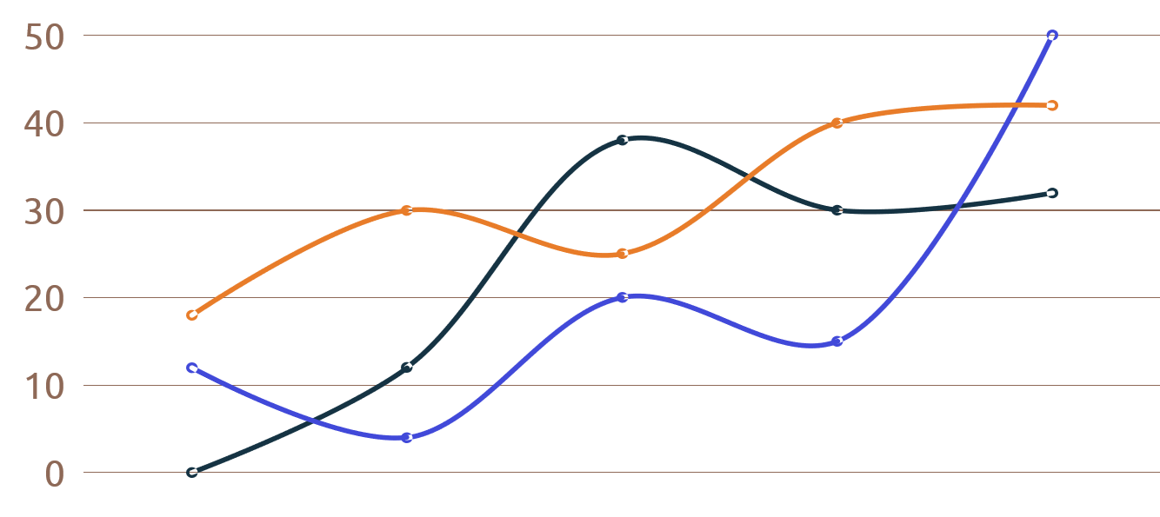
Tips from Best Practices
Consider a partnership with a university as a part of a student thesis or capstone, your court may be able to partner for much lower cost and high expertise
A full program evaluation should occur every 3-5 years using an independent evaluator if possible
Before the Evaluation, decide who “owns” the data, where it will be housed and how it will be used.

Slide 18


The end
The Challenges Associated with Data Collection can be daunting
But the rewards are obvious when we see families thriving
Read more on our website

