Slide 1


Family Treatment Court Best Practice Standards
1F: Communication and Information Sharing
1G: Cross-Training and Interdisciplinary Education

Slide 2





Funding and Partners Acknowledgement
2020-AR-BX-K001
This project is supported by Grant # 2020-AR-BX-K001 awarded by the Office of Juvenile Justice and Delinquency Prevention, Office of Justice Programs, U.S. Department of Justice. The opinions, findings, and conclusions or recommendations expressed in this publication/program/exhibition are those of the author(s) and do not necessarily reflect those of the Department of Justice or our partner organizations.

Slide 3
Best Practice 1 Provisions check in
Provision A: Collaboration
Provision B: Community Partnerships
Provision C: Multidisciplinary Team
Provision D: Governance Structure
Provision E: Shared Mission and Vision
Provision F: Communication and Information Sharing
Provision G: Cross-Training and Interdisciplinary Education

Slide 4
Provision F: Communication and Information Sharing
Reporting
Reports from Social workers, Treatment & Mental Health Providers, and/or any other Professionals that can give progress information to the FTC Operational Team
  Typically given to FTC Coordinator a few days before court hearing is scheduled – dependent on policy and MOUs
Staffing Report
  FTC Coordinator coalesces that information in a clear, efficient way that focused on problem-solving for that case
  Reports are given out and read by all team members prior to staffing

Slide 5
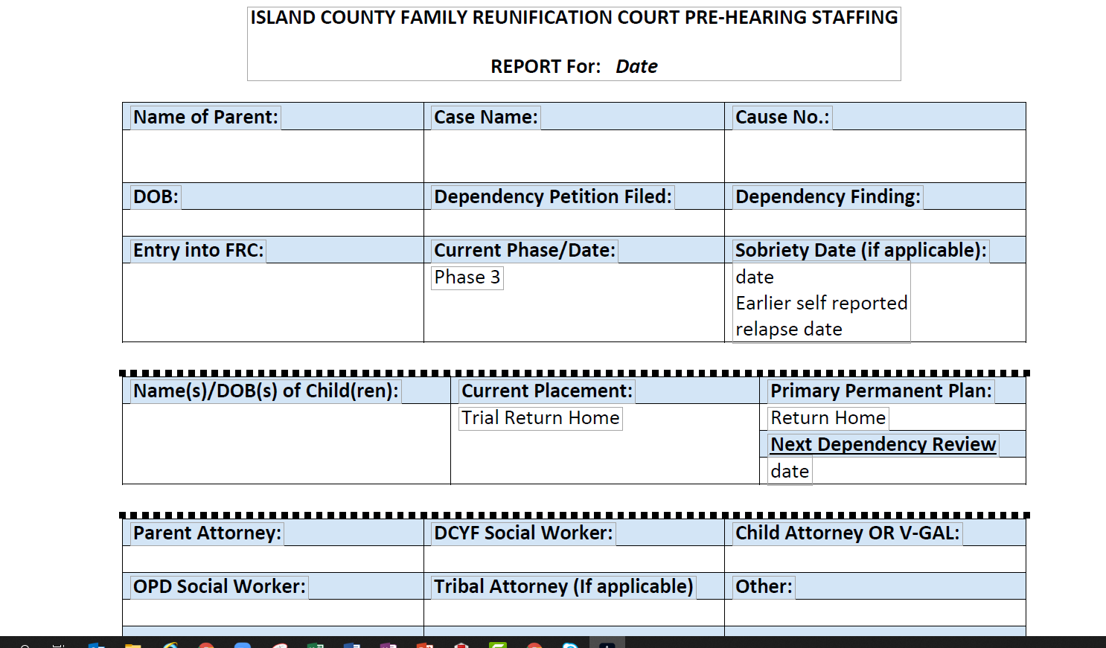
Sample Staffing Report

Slide 6
Confidentiality
Confidentiality requirements should be upheld for each member of the team according to the ethical mandates of their profession.
MOUs should detail these confidentiality requirements, and MOUs should be reviewed on a yearly basis to be sure information sharing is upheld to the standards required by those professionals
Parties to the case are still to be given all information they are legally entitled to, other information is shared based on the details of your courts consent forms.

Slide 7
FTC Adjacent Members
County Family Treatment Court
Local Steering Committee or Community Stakeholders Team
Local Oversight/Policy and Procedures Team
Local Operational Team

Slide 8
Let’s Talk About Consent
Participant Consent Form
Exchange of Confidential Information Disclosure during Pre-Court Staffing
Must identify each team member, by name
Specify an end date, or a specific event which ends the consent (FTC dismissal or graduation)
If a visitor attends court, they must sign a nondisclosure form to protect the confidentiality of the client

Slide 9
Family Treatment Court Confidentiality
The FTC is considered a “treatment program” according to Federal Confidentiality laws because Social Workers and Treatment Providers are “covered entities”
Consent Forms and Reporting Process should follow
HIPPA (Health Insurance Portability and Accountability Act
42 Code of Federal Regulations (CFR)

Slide 10
Provision G: Cross Training and Interdisciplinary Education
Research has shown consistently that all members of a team are more effective if they are receiving ongoing training and technical assistance.
Operational Team needs ongoing training in:
Roles and Responsibilities
Best Practice Standards
Changes and Updates to Operational Structure of the FTC
A comprehensive onboarding process for new members

Slide 11
Crossing Training
As an interdisciplinary team, all members can benefit from mutually beneficial topics such as:
Justice, Diversity, Equity, and Inclusion (JEDI or DEI) topics
Adoption and Safe Families Act (ASFA)
State child welfare standards
  Family Time Law
  Plans of Safe Care
Indian Child Welfare Act, Tribal Mandates and Laws, Local Tribal Cultural Practices
Child Abuse Prention and Treatment Act
Substance Use, Trauma, Mental Health Disorders, Effective Treatment Approaches

Slide 12
Suggestion
Many teams find a brown-bag cross training opportunities developed by members of the team both cost and time effective
New Members should review policy and procedures manuals, meet with each team member, and observe a pre-court staffing and review hearing
Each team member should consider mentoring a replacement in case of illness and to ensure a smooth transition if they receive a new position

Slide 13
Best Practice 1 Provisions check in
Provision A: Collaboration
Provision B: Community Partnerships
Provision C: Multidisciplinary Team
Provision D: Governance Structure
Provision E: Shared Mission and Vision
Provision F: Communication and Information Sharing
Provision G: Cross-Training and Interdisciplinary Education

