Slide 1
Family Treatment Court Best Practice Standards 1c: Multidisciplinary Team 1d: Shared Governance 1e: Shared Mission & Vision

Slide 2
Funding and Partners Acknowledgement
2020-AR-BX-K001
This project is supported by Grant # 2020-AR-BX-K001 awarded by the Office of Juvenile Justice and Delinquency Prevention, Office of Justice Programs, U.S. Department of Justice. The opinions, findings, and conclusions or recommendations expressed in this publication/program/exhibition are those of the author(s) and do not necessarily reflect those of the Department of Justice or our partner organizations.

Slide 3
Provisions check in
Provision A: Collaboration
Provision B: Community Partnerships
Provision C: Multidisciplinary Team

Slide 4
Provisions check in
Provision A: Collaboration
Provision B: Community Partnerships
Provision C: Multidisciplinary Team – Brings in the expertise needed to help families with a wide variety of needs

Slide 5
How to Build a Multidisciplinary Team
Who should we include? What should we consider?
?

Slide 6
How to Hire a Multidisciplinary Team
Provision C says that
“implementation research suggests that individuals be selected to the values of an organization. An individual can be trained to do a particular job, but cannot necessarily be trained to believe in a particular value.” p. 16 FTC Best Practice Standards

Slide 7
How to Hire a Multidisciplinary Team
Does your FTC team have a shared mission and vision?

Slide 8
How to Hire a Multidisciplinary Team
Does your FTC team have a shared mission and vision?
Best Practice Standard 1, provision E gives evidence that a shared mission and vision statement can have a positive impact on organizational performance, and can increase organizational innovation.

Slide 9
Mission and Vision Guide Values
Without a shared mission and vision for your team – hiring or building a team for values that you all uphold will be a challenge.

Slide 10
What expertise are we looking for?
Multidisciplinary Team – Brings in the expertise of child welfare, SUD treatment, quality legal representation, ethical standards, experts in law
Notes:
https://equity.wa.gov/policy/executive-orders

Slide 11
Washington Diversity and Inclusion
Multidisciplinary Team – Brings in the expertise of child welfare, SUD treatment, law
Expertise in culture, representation, removing bias, understanding of the families we serve – those with lived experience
Notes:
https://equity.wa.gov/policy/executive-orders

Slide 12
Washington Diversity and Inclusion
Multidisciplinary Team – Brings in the expertise of child welfare, SUD treatment, law
Expertise in culture, representation, removing bias, understanding of the families we serve – those with lived experience
Equality and Justice for All is the Law
Notes:
https://equity.wa.gov/policy/executive-orders

Slide 13
Hiring and Implicit Bias
Implicit Bias definition: when we have attitudes towards people or associate stereotypes with them without our conscious knowledge.
Implicit Bias test: https://implicit.harvard.edu/implicit/takeatest.html

Slide 14
Dismissing Black applicants due to implicit bias
Influential work in implicit bias research from 2003 experiment called:
Are Emily and Greg More Employable than Lakisha and Jamal? A Field Experiment on Labor Market Discrimination
Results:
Responded to1300 employment ads and sent 500 resumes
50% more callbacks for interviews for White names version African American names
Uniform across occupations and industries
You can read the original paper here: https://www.nber.org/papers/w9873

Slide 15
Removing bias =
Subjectivity

Slide 16
Less Subjective Criteria
Decide beforehand what criteria are necessary to do the work
Place value in knowledge and understanding on equity
Ask team members questions about equity and inclusion
Use a rubric and scoring system that is decided prior to seeing application materials

Slide 17
Example hiring questions
Diversity of experience: How might a person’s background impact their success in navigating the child welfare system?
Inclusion: What practices would you try to incorporate to make sure all members of a family arrive in court and feel safe and that their needs will be met?
Valuing diverse opinions: I will give an example of a time in a working group when colleagues from diverse backgrounds have very different approaches to a situation. Tell me what you notice about their viewpoints and what you might be able to take from both positions.
Policies that are designed to ensure equity and inclusion often become out of date and ineffective. From your point of view, why does this happen, and what can we do to ensure our practices are effective?

Slide 18
Don’t fall into the trap of “Being a good fit”
While trusting our intuition is valuable in some cases – it also introduces a grey area of subjectivity that allows bias to creep in.
Often being a good fit means someone who “fits with the team”,
however challenging a team is a strength when it is challenging stereotypes or bias.
Can you break down why someone is or is not a good fit? Are there objective reasons?

Slide 19
Some thoughts on “Being a good fit”
Consider the stereotype of an “Angry Black woman”
Anger expressed by Black women in the workplace is more likely to result in a negative performance evaluation and negative assessment of leadership capability
From Race and Reactions to Women’s Expressions of Anger at Work: Examining the Effects of the “Angry Black Woman” Stereotype
Or an “Emotional Latina/o” who is told to conform more to get ahead
Found that 76% of Latinos repress parts of their personas at work.
“too expressive”
“tone down the hands”
Notes:
https://www.apa.org/pubs/journals/releases/apl-apl0000884.pdf
https://hbr.org/2016/10/u-s-latinos-feel-they-cant-be-themselves-at-work

Slide 20
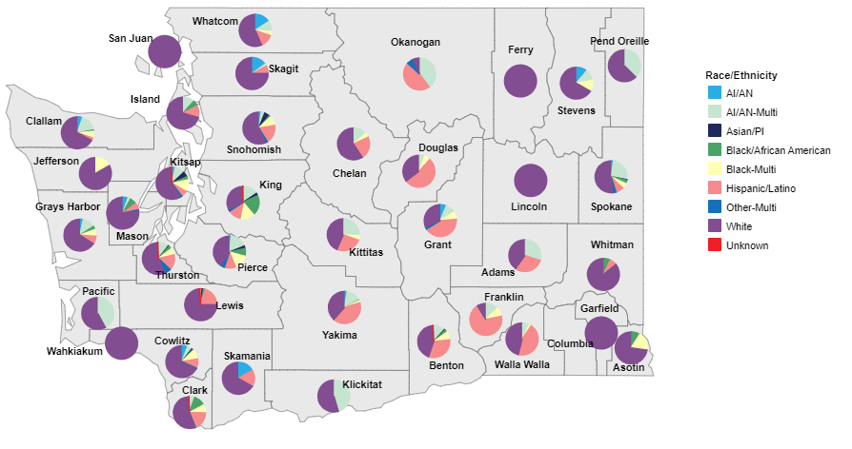
Some thoughts on “Being a good fit”
If the dependency demographics of the population we serve is 47% Hispanic/Latino (Okanogan), 21% African American/Black (King), or 17% Multiracial American Indian/Alaska Native (Clallam) – 2020 Interactive Dependency Dashboard
Notes:
https://www.apa.org/pubs/journals/releases/apl-apl0000884.pdf

Slide 21
Does the “fit” to your team matter more than the “fit” to our population?
If the population we serve is 47% Hispanic/Latino (Okanogan), 21% African American/Black, or 17% Multiracial American Indian/Alaska Native (Clallam) – 2020 Interactive Dependency Dashboard
Notes:
https://www.apa.org/pubs/journals/releases/apl-apl0000884.pdf

Slide 22
Some thoughts on “Being a good fit”
If the dependency demographics of the population we serve is 47% Hispanic/Latino (Okanogan), 21% African American/Black (King), or 17% Multiracial American Indian/Alaska Native (Clallam) – 2020 Interactive Dependency Dashboard
Then being culturally understood and represented by an FTC court team may well be more important than a bachelor’s degree in criminal justice or an understanding of Microsoft office.
Notes:
https://www.apa.org/pubs/journals/releases/apl-apl0000884.pdf

Slide 23
Bringing this back to BP 1
Remember that a Multidisciplinary Team is built on the values of your court, one of those values is a diverse team that has the expertise families need to change their lives.

Slide 24
Provisions check in
Provision A: Collaboration
Provision B: Community Partnerships
Provision C: Multidisciplinary Team
Provision E: Shared Mission and Vision
Provision D: Governance Structure

Slide 25
Provisions check in
Provision A: Collaboration
Provision B: Community Partnerships
Provision C: Multidisciplinary Team
Provision E: Shared Mission and Vision
Provision D: Governance Structure

Slide 26
BP1 Provision D
Governance at the State level:
Washington FTC Steering Committee
Washington FTC Grant Team + Partners

Slide 27
BP1 Provision D: Local Governance Structure
County Family Treatment Court
Local Steering Committee or Community Stakeholders Team
Local Oversight/Policy and Procedures Team
Local Operational Team

Slide 28
BP1 Provision D: Local Governance Structure
County Family Treatment Court
Local Steering Committee or Community Stakeholders Team
Local Oversight/Policy and Procedures Team
Local Operational Team
Organizes, facilitates, or attends staffing
Submits information or collects and distributes information for staffing and committees
Problem Solve between hearings
Administrative tasks
Work specific to their roles of the team
Data collection and dissemination

Slide 29
BP1 Provision D: Local Governance Structure
County Family Treatment Court
Local Steering Committee or Community Stakeholders Team
Local Oversight/Policy and Procedures Team
Policy and Procedure Decisions
Updates to the Policy and Procedure Manual
Discussion of Entrance and Phasing Requirements
Identification of Needs outside of hearings and staffing
Local Operational Team

Slide 30
BP1 Provision D: Local Governance Structure
County Family Treatment Court
Local Steering Committee or Community Stakeholders Team
Local Oversight/Policy and Procedures Team
Local Operational Team

Slide 31
BP1 Provision D: Local Governance Structure
Local Oversight/Policy and Procedures Team
Local Steering Committee or Community Stakeholders Team
Decision Makers in the community
Executives of Service Providers
Leaders in child welfare
Local Government
Focus: Problem solving
Meets Quarterly
Local Operational Team
County Family Treatment Court

Slide 32
Best Practice 1 Provisions check in
Provision A: Collaboration
Provision B: Community Partnerships
Provision C: Multidisciplinary Team
Provision D: Governance Structure
Provision E: Shared Mission and Vision

