Slide 1
Washington Family Treatment Courts Best Practice Standards Training
Best Practice 1: Organization and Structure
Facilitator: Meghan R. Fitzgerald, PhD

Slide 2
Funding and Partners Acknowledgement
2020-AR-BX-K001
This project is supported by Grant # 2020-AR-BX-K001 awarded by the Office of Juvenile Justice and Delinquency Prevention, Office of Justice Programs, U.S. Department of Justice. The opinions, findings, and conclusions or recommendations expressed in this publication/program/exhibition are those of the author(s) and do not necessarily reflect those of the Department of Justice or our partner organizations.

Slide 3
Learning Goals Best Practice Standard 1: Organization and Structure
Understand the 10 provisions identified in the Best Practice guide regarding the structure and organization of an FTC
Gain clarity about how each member of a local Family Treatment Court supports the structures and organization development of the FTC.
To make actionable goals to create sustainability in your local FTC.

Slide 4
Materials
Mindfulness tools
FTC Best Practice Pdf or Printed Booklet
Note taking tools
Materials from your court: Policy and Procedure Manual, MOU documents, Participants Manual, and any other developed materials that could use review.
Prepare to pause and reflect

Slide 5
Summary of Best Practice 1
“FTC has agreed upon structural and organizational principles that are supported by research and based on evidence informed policies, programs, and practices. The core programmatic components, day-to-day operations, and oversight structures are defined and documented in the FTC policy and procedure manual, participant handbook, and memoranda of understanding (MOUs)”
Family Treatment Court Best Practice Standards p. 10

Slide 6
Provisions of Best Practice 1
Multidisciplinary and Multisystemic Collaborative Approach
Partnerships, Community Resources, and Support
A Multidisciplinary Team
Governance Structure
Shared Mission and Vision
Communication and Information Sharing
Cross-Training and Interdisciplinary Education
Family-Centered, Culturally-Relevant, and Trauma-Informed approach
FTC Policy and Procedure Manual
FTC Pre-Court Staffing and Court Review Hearing

Slide 8
A. Multidisciplinary and Multisystemic Approach Rationale
Child Welfare
SUD Treatment
Dependency Court

Slide 9
A. Difficulties of Working With a Diverse Team
Difficulties that arise from this approach:
The partner organizations and agencies working to support families entering into a Family Treatment Court have different approaches and different roles to play within the model. This may cause friction within the team if not addressed, which will translate into lower success for clients.

Slide 10
A. Ameliorating the Difficulties
Developing shared agreements for working together with a broad range of partners that are able to address a family’s needs at all levels
Ensuring that all members have clear responsibilities and expectations
Open Communication and an understanding of a common goals are critical
Agreements, team goals, roles and responsibilities should all be documented for clarity and accountability

Slide 11
Take moment to think
What “agreements” are important to you to be successful in a collaboration?
Has your team ever discussed what helps them work best together?
Take a second to look over your policy and procedure manual – is there a section that defines the roles and responsibilities of members of the FTC Team? Does it include what happens in members are not meeting those expectations?
Can you think of any strategies to bring back to your team to start documenting these needs?

Slide 13
Sample of the research behind these recommendations
Bruns, E. J., Pullmann, M. D., Weathers, E. S., Wirschem, M. L., & Murphy, J. K. (2012). Effects of a Multidisciplinary Family Treatment Drug Court on Child and Family Outcomes: Results of a Quasi-Experimental Study. Child Maltreatment, 17(3), 218–230. https://doi.org/10.1177/1077559512454216

Slide 14
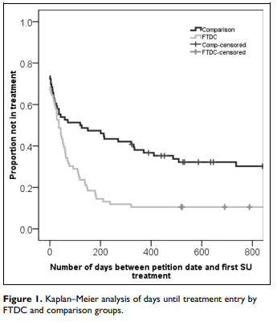
Effects of an FTC on Child and Family Outcomes

Slide 15
Some Final results from Bruns et al.
At the end of the study Children whose parents participated in FTC were 2.5 times more likely to be returned home and case dismissed (27 of children in FTC vs 11 in comparison).
If case still ongoing at the end of the study, less kids remained in an out-of-home placement at the end of the study window (24 children in FTC vs 46 in comparison group.

Slide 16
A Quiz
A quiz on provision A

