Slide 1
Washington Family Treatment Courts Best Practice Standards Training
Best Practice 2: The Role of the Judge
Facilitator: Meghan R. Fitzgerald, PhD

Slide 2
Funding and Partners Acknowledgement
2020-AR-BX-K001
This project is supported by Grant # 2020-AR-BX-K001 awarded by the Office of Juvenile Justice and Delinquency Prevention, Office of Justice Programs, U.S. Department of Justice. The opinions, findings, and conclusions or recommendations expressed in this publication/program/exhibition are those of the author(s) and do not necessarily reflect those of the Department of Justice or our partner organizations.

Slide 3
Learning Goals Best Practice Standard 2: The Role of the Judge
Understand the 6 basic provisions identified in the Best Practice guide regarding the role of a judicial officer
Gain clarity about how each member of a local Family Treatment Court supports the judicial officer their role

Slide 4
A moment for reflection
Does the judge or commissioner of your FTC set a tone for the court that you believe is in line with best practice standards?
Does the court feel inclusive? Are concerns addressed? Do professionals feel heard and included? Do participants feel safe and supported? Are inequities and biases addressed?
Identify qualities that seem critical to being effective in this role.

Slide 6
6 provisions in Best Practice 2
Convening Partners
Judicial Decision Making
Participation in FTC Pre-Court Staffing
Interaction with Participants
Professional Training
Length of Judicial Assignment to the FTC

Slide 7
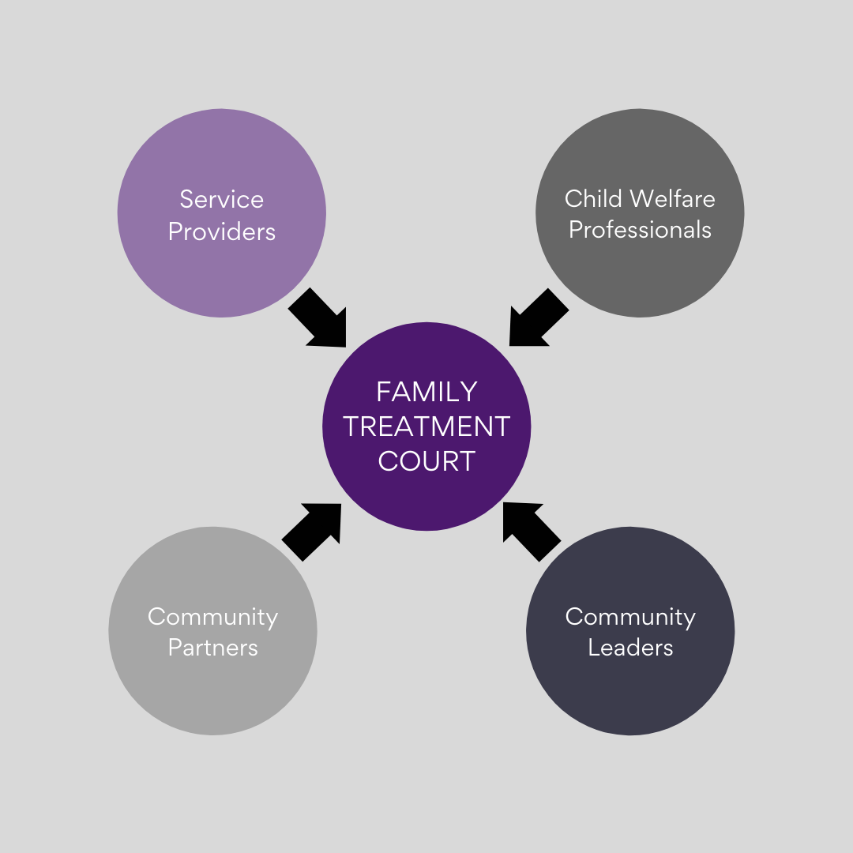
A. Convening Partners

Slide 8
A. Convening Partners

Slide 9
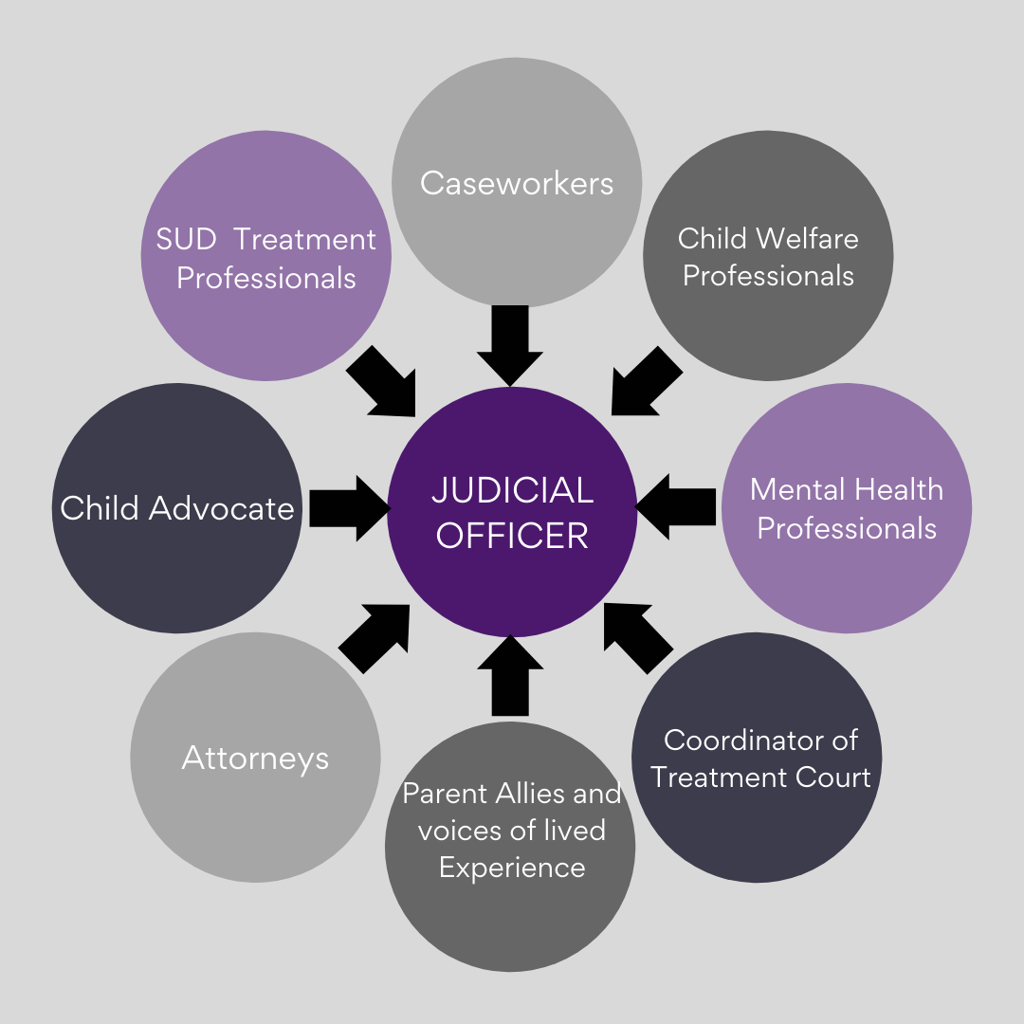
A. Convening Partners

Slide 10
Pre-court staffing quiz
A four question quiz will show on your screen
For CLEs, CJEs, or a certificate of completion. Please use your full name and email address to complete this quiz.

Slide 11
C. Participation in Pre-Court Staffing
An analysis of the data from three major studies including 125 evaluations and 32, 719 participants in drug courts across the nation found that
“Team Engagement” in which all of the team members attend case staffing and court sessions
was one of 7 practices that related to “higher graduation rates, lower recidivism, and greater costs savings”
Download the pdf from NPC research here, The citation is also found on page 38 of your FTC best practice manual

Slide 12
C. Pre-court staffing
Leadership
Question
Listen and Learn
Focus on strengths and solving problems
Judicial and case law expertise
Set the tone
Ethical court conduct and responses
Equity is enforced and objectivity is the goal
Confronting bias

Slide 13
B. Judicial decision making
“The judge is ethically bound to exercise independent discretion and make independent decisions after hearing from all parties and reviewing the relevant facts and applicable laws.”
Family Treatment Court Best Practice Standards p. 34

Slide 14
E. Professional training
Your FTC team, AOC, and CFF offer trainings on a regular basis that we’ve seen many of our judicial officers attend.
Three areas that should be considered for both the judicial officer and for your whole team are:
Training on relevant topics to the whole FTC or to the judicial role.
Cross-training within the operational team
Shared learning experiences, consultation, and networking with other judicial officers, both from a learning perspective and from a teaching perspective when that's appropriate

Slide 15
F. Length of judicial Assignment to the FTC
The best practice standard:
“a judge provides presides over the FTC for at least two consecutive years to maintain continuity for children, parents and for families”
+ Plan for succession

Slide 16
D. Interaction with Participants
3 minutes with each participant
Strengths based
Family Focused
Ask about parenting goals
Parenting Time
Medical and Educational needs from parents perspective
Parenting Challenges
Explains decisions
Allows the participant to feel heard

