Slide 1
Best Practice Standards 1-8
Washington Family Treatment Courts will share an example of a best practice standard being applied in their court.

Slide 2
Best Practice Standard 1: Organization & Structure
Okanogan County
Family Treatment Court
Krisana Shrable

Slide 3

Best Practice 1: Structure and Organization
Brief Summary from 2019 Best Practice Standards: The family treatment court (FTC) has agreed-upon structural and organizational principles that are supported by research and based on evidence-informed policies, programs, and practices. The core programmatic components, day-to-day operations, and oversight structures are defined and documented in the FTC policy and procedure manual, participant handbook, and memoranda of understanding (MOUs).

Slide 4
Governance Structure; Okanogan County
Policy Team-meets monthly to discuss the overall operations of FTC to include ways to improve program practices, identify upcoming trainings, identify and examine progress and direction of FTC. Includes Staffing Team representatives and other community partners who have a vested interest in the day to day operations of FTC.
Staffing Team “Core FTC Team”-meets bi-weekly (more often as assessed and needed) to discuss families., led by our FTC Judge and Core FTC Team. Also responsible for reviewing referrals, applications and level advancements. Staffing’s include Parent/s, Child/ren and Family (holistic approach)
Steering Committee – needed in order for our FTC to be sustainable. What does our community need in order to provide support and services to children, parents and families? Need to identify community partners, seeking members/volunteers. Possibly meeting quarterly? Identifying direction, resources and funding.

Slide 5

FTC Team: A Multidisciplinary Approach
Okanogan County’s FTC Team consists of:
Judicial Officer, FTC Coordinator, FTC Case Manager, SUD Provider, MH Provider, Parent/s Attorney, Child/ren Attorney, Assistant Attorney General (DCYF), DCYF Supervisor and Community Partners (Worksource and Hope Transportation)
Parent Ally, FTC Designated Social Worker and Recovery Coach are also components of the team we’ve had discussion about and are looking into

Slide 6
Best Practice Standard 2:
The Role of the Judge
Whatcom County
Family Treatment Court
Commissioner Henley

Slide 7
Establish and Maintain Rapport with FTC Participants at Court Hearings
Forge a positive relationship with FTC participants in the short time you have with them at each court hearing
Build FTC participants’ self-confidence and strengthen their connection to the FTC process by providing them mostly positive feedback
Overcome the dynamics of the power imbalance between you and the FTC participants by helping them feel comfortable talking with you in the court room
Rely on your FTC team members for positive information about FTC participants and how best to motivate them to succeed

Slide 8
Best Practice Standard 3:
Ensuring Equity & Inclusion
Scenario for Discussion with Local Operational Team

Slide 9
Best Practice 3 Scenario (on website and chat)
Sara a mother of 2 children, ages 2 months and 4 years old has recently entered into your FTC. Sara identifies as a Black woman and her children are Black as well. The biological father of both children is currently in another state and is not a viable placement for the children, so they are residing with Sara’s mother. Treatment reports that Sara is fully engaged and is working well in one on ones with her treatment provider. She has also been present and interactive in family time, and is overall meeting all of her plan goals. However Sara can be argumentative and angry in court. She is often quiet, rarely makes eye contact with the Judge or her lawyer, and shakes her head as her social worker and the attorney for DCYF are talking. She has mentioned that she feels like FTC is “out to get her” and that she knows she “can’t trust the court.”
Discuss what, if any, cultural issues might be present here.
Discuss what, if any, trauma issues might be present here.
Look at this from Sara’s perspective, how might she see this situation differently than the members of your team?
Discuss a response to this behavior that is in line with the best practice standards and any issues you have noticed above.
What are some trauma-responsive practices you could put into place to make Sara feel comfortable? Could you put any of these into place now?

Slide 10
Scenario Debrief
Some topics that may have come up:
Systemic Racism:
Distrust of the Court System as a whole based on treatment of Black community members
Stereotypes/checking personal bias
Trauma from historic oppression
Power Dynamics
Trauma Responses – quiet, anger, frustration, inattentiveness, misperception
Advocating for yourself vs presenting emotion in court

Slide 11
How can we make this participant more comfortable?
Patience
Recognition of past experiences. Name them, talk about them when appropriate
Create a multicultural, trauma-sensitive environment
Build relationships, be humans
Reduce Power dynamics where possible – can your judge join a casual meeting with the coordinator?
Hire with an eye for people who value all of our participants and have an understanding of their experiences

Slide 12
Best Practice Standard 4:
Early Identification, Screening and Assessment
Pierce County
Family Recovery Court
Cathie Case

Slide 13

Best Practice Standard 4: Early Identification, Screening, and Assessment
PRE SHELTER CARE IDENTIFICATION:
Working together:
Department, Treatment, and Parent’s Attorney and getting early screening hearings (early engagement)
SHELTER CARE-FF IDENTIFICATION:
Parent’s Attorney referrals
It is never too late: screening within 6 months but special circumstances could apply.
SCREENING HEARING:
Parent’s Attorney needs to explain program and documents
Parent can participate in Treatment early (no need to wait until screening hearing to get Tx date).
Treatment Provider
Department
Parent Attorney
TREATMENT ASSESSMENT:
Goes over program and treatment requirements, gets assessments, gets evaluated for all supportive services/needs, gets visits set up, emails to all parties with update, work on detox/inpatient if needed.

Slide 14
Best Practice Standard 5:
Timely, High-Quality, and Appropriate Substance Use Disorder Treatment
Zach Mezel
Pierce County
Family Treatment Court

Slide 15
Timely, High-Quality, and Appropriate Substance Use Disorder Treatment
Brief Summary from 2019 Best Practice Standards: Substance use disorder (SUD) treatment is provided to meet the individual and unique substance-related clinical and supportive needs of persons with SUDs. For participants in family treatment court (FTC), it is important that the SUD treatment agency or clinician provide services in the context of the participants’ family relationships, particularly the parent-child dyad, and understand the importance of and responsibility for ensuring child safety within the Adoption and Safe Families Act timeline for child permanency. A Treatment provider’s continuum of services includes early identification, screening, and brief intervention; comprehensive standardized assessment; stabilization; appropriate, manualized, evidence-based treatment including medications if warranted; ongoing communication with the FTC team; and continuing care. The parent, child, and family treatment plan is based on individualized and assessed needs and strengths and is provided in a timely manner including concurrent treatment of mental health and physical health.

Slide 16
Timely, High-Quality, and Appropriate Substance Use Disorder Treatment
Pierce County Alliance Family Recovery Court has two SUD counselors working directly with all FRC participants entering the program
Treatment Providers participate in weekly staffing, FTDM staffing and PP staffing to discuss participant progress, barriers to success and level of care
Specific unique needs ideally identified in assessment process, continually evaluated and adjusted as necessary through FTC/Treatment Process
Focus on integrating expedited access to treatment
Curriculum that incorporates SUD and parenting skills
Incorporation of SUD and DCYF goals into milestones for better participant understanding

Slide 17
Best Practice Standard 6:
Comprehensive Case Management, Services, and Support for Families
Mason County
Family Therapeutic Court
Renee Cullop, Daniel Goodell

Slide 19
Best Practice Standard 7:
Therapeutic Responses to Behavior
Cowlitz County
Hope Court
Michael Evans, Adam Pithan, Jade Cassio

Slide 20

Therapeutic Responses to Behavior
Cowlitz County HOPE Court
Judge Michael Evans
Adam Pithan – Therapeutic Courts Manager
Jade Cassio – HOPE Court Case Manager

Slide 21
BP 7 Scenario (on website and chat)
Amber successfully completed long term inpatient treatment three weeks ago and returned to the community. Her children (ages 8 months and 2 ½ years) are on a Trial Return Home (they were placed with her while she was inpatient). Amber is struggling to attend all of her services and feels overwhelmed. She just passed her 6 month sober date. Although Amber has provided all random UAs (results negative), she is not making all of her outpatient groups. Amber is supposed to attend two sober supports/week and didn’t turn in any slips.
What might be the underlying cause of Amber’s attendance/compliance struggles?
Identify the specific behavior(s) we are helping Amber to change (hint, there are more than one)
What therapeutic response might support Amber’s continued success?
Are there other responses you’d like to suggest for Amber?

Slide 22
Scenario Debrief
What behavior(s) did you identify in this scenario?
Time-management, meeting commitments, prioritizing
Reaching out for help when overwhelmed
Timely and honest accounting of needs
Some praise deserved for:
Six month sober date, making UAs, kids are safe
Information Needed: Does she have transportation? Does she have childcare during meetings? Health needs? Emotional Needs? Has she talked to providers? Is she being honest?
Help needed: Environment is less structured

Slide 23
Best Practice Standard 8:
Monitoring & Evaluation
King County
Family Treatment Court
Jill Murphy

Slide 24
Monitoring and Evaluation
Brief Summary from 2019 Best Practice Standards: The family treatment court (FTC) collects and reviews data to monitor participant progress, engage in a process of continuous quality improvement, monitor adherence to best practice standards, and evaluate outcomes using scientifically reliable and valid procedures. The FTC establishes performance measures for shared accountability across systems, encourages data quality, and fosters the exchange of data and evaluation results with multiple stakeholders. The FTC uses this information to improve policies and practices in addition to monitoring the strengths and limitations of various service components. Evaluation results and data are also critical components of effective stakeholder outreach and sustainability helping the FTC “tell its story” of success and needs

Slide 25
Monitoring and Evaluation
Summarize the process of data collection in your court, particularly focusing on how you use the data you collect to modify and improve your services, equity, and policies/procedures.
Consider adding information from one or two these prompts (if applicable to your court) related to best practices. Remember, you only have 5 minutes so focus on telling a specific story with the information rather than discussing all the prompts.
Give a specific data “story” – information you collected that helped you identify a problem (and how), what changes you made, and how the data changed as a result
Walk us through a report you would use in staffing, how data is received from service providers, and how that report is used to make informed decisions in staffings and court.
Discuss a process of change in your data collection – why you made that change, what help you received, and if there has been a positive or negative impact on the practices
Do you have a process for evaluation of service providers? Discuss that process and what is involved?
How often do you provide data to stakeholders outside your local team? What methods have you used to keep stakeholders up to date?

Slide 26
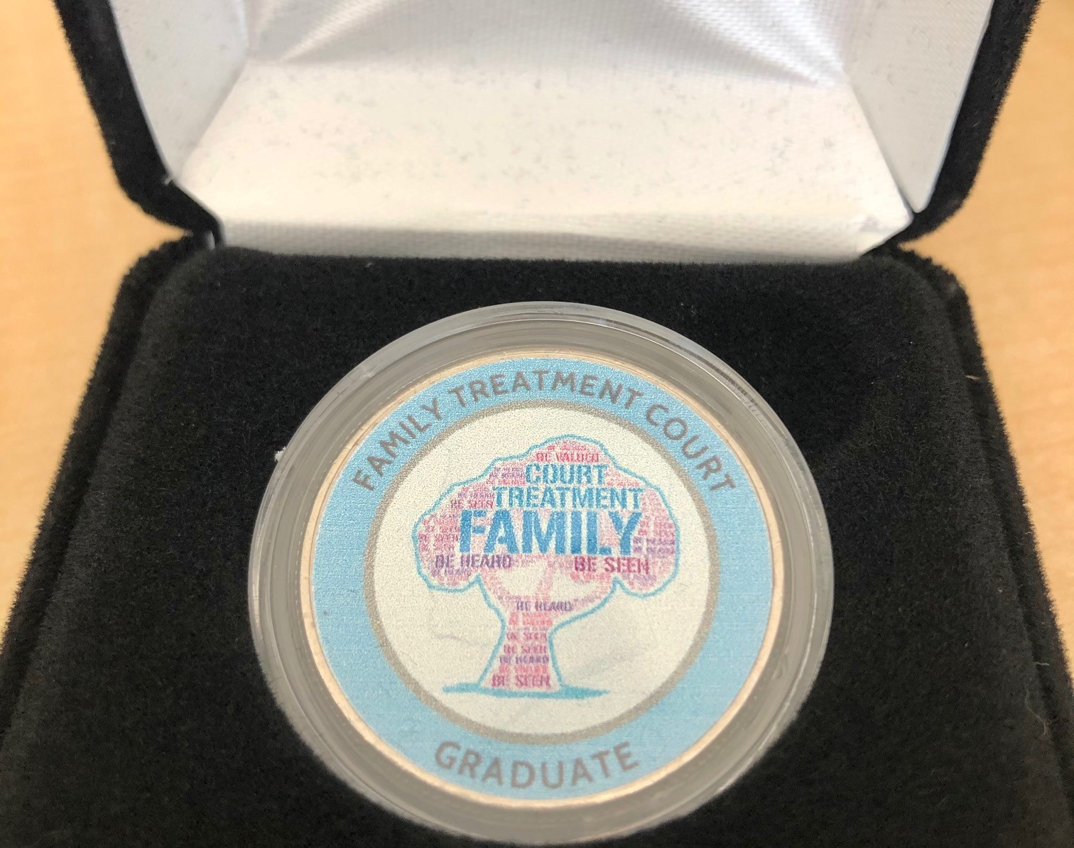
King County FTC Monitoring and Evaluation Tips!
Quarterly and Annual Reporting to Governance Structure Levels
Drop Off Analysis for Equity Checks and Balances
Using data to advocate for needed services
A local MIS is key, but so are external evaluations!
Programs evolve and databases need to as well:
-What reports are needed?
-What fields are important?
-What are the data entry timelines?
-Who enters the data?

