Slide 1
Family Treatment Court Best Practice Standards: An Overview

Slide 2
Funding and Partners Acknowledgement
2020-AR-BX-K001
This project is supported by Grant # 2020-AR-BX-K001 awarded by the Office of Juvenile Justice and Delinquency Prevention, Office of Justice Programs, U.S. Department of Justice. The opinions, findings, and conclusions or recommendations expressed in this publication/program/exhibition are those of the author(s) and do not necessarily reflect those of the Department of Justice or our partner organizations.

Slide 3
Accessibility and Information Equity Information
We are dedicated to developing training materials with equitable access to information, please give feedback if we can improve!
Transcript and captioning
Accessible handouts available as pdf and editable word documents
All materials are licensed as creative commons attribution – Non Commercial – Share Alike (CC BY_NC_SA 4.0) except logos used by other organizations.

Slide 4
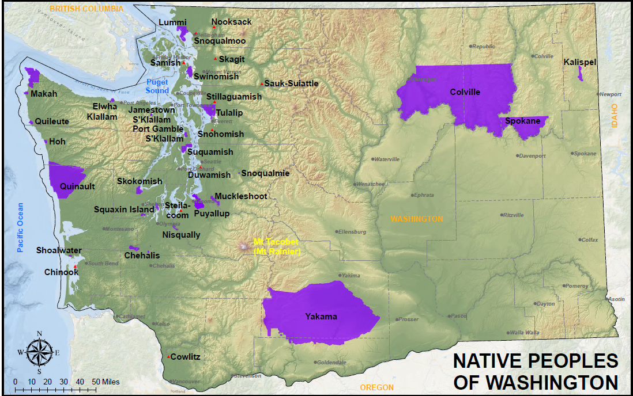
Land Acknowledgements
Dr. Meagan Rides at the Door
National Native Children’s Trauma Center
https://www.nnctc.org/
Map credit to the Puyallup Tribe of Indians website: http://puyallup-tribe.com/gis/downloads/NativePeoplesOfWashington_Web.pdf

Slide 5
Land Acknowledgement
This video was created in Bellingham, WA, ancestral home of the Lummi and Nooksack Tribes. These tribes which were moved and divided by the (contested) Treaty of Point Elliot in 1855 and the reservation system established in the years following. Prior to colonial times the Lummi moved throughout the San Juan Islands (pictured) and the Nooksack through the upper bay and river valley.
For more info: https://www.npaihb.org/member-tribes
If you’d like to create a Land Acknowledgement with your team, download our meeting guide.

Slide 6
Learning Goals
After this training you will:
Understand the background to the development of these standards (evidence based!)
Know where to find more information on the Best Practice Standards
Be able to name and describe each of the 8 best practice standards and create plans for implementation
Modules will be broken up by Standard and will be released as they are ready, starting with Best Practice 1 and 2.

Slide 7
Photo by Danielle MacInnes on Unsplash

