Slide 1


Washington Family Treatment Courts
First All Sites Meeting
Brought to you by AOC’s Family and Youth Justice Programs

Slide 2
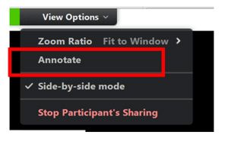
Draw a self- portrait using annotate while you wait:
At the top of your screen
then
then

Slide 3
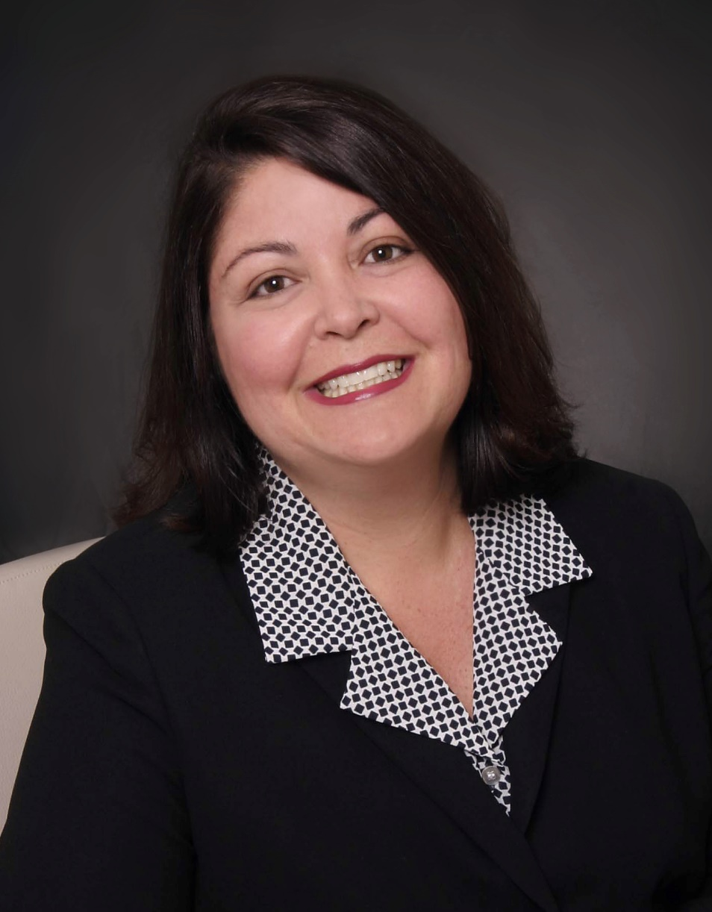
Welcome to the First FTC All Sites Meeting
DAWN MARIE RUBIO has worked on behalf of state courts for her entire 30-year legal career. She joined the Washington Administrative Office of the Courts as State Court Administrator on January 1, 2019. Previously, Rubio worked with the Utah Administrative Office of the Courts, where she served as the Juvenile Court Administrator for Utah’s statewide Juvenile Court and was appointed as Utah’s Commissioner for the Interstate Commission for Juveniles. She also worked as the Assistant Director of the Administrative Office of the Illinois Courts. For 11 years, Rubio was a Principal Court Management Consultant with the National Center for State Courts, and she directed national, state, and local projects improving court organization, processes, and court operations involving children, families, and problem-solving courts. She received NCSC’s 2006 Staff Excellence Award. She began her career in Florida with the Seventeenth Judicial Circuit Court Administrator’s Office. She is a trained mediator and a member of the Florida Bar Association. Bachelor of Science (psychology) and Juris Doctor, University of Florida. Fellow, Court Executive Development Program, Institute for Court Management.

Slide 4
Housekeeping
Feel free to use the chat, reactions, or leave your camera on and give us a thumbs up or a smile
We will be monitoring the waiting room, come and go as needed
Break out rooms between 10 and 12 – cameras on them if at all possible
If you miss something, all materials are on the All Sites Website
Notes:
Website: https://www.wacita.org/washington-ftc-all-sites-meeting-details-and-resources/

Slide 5
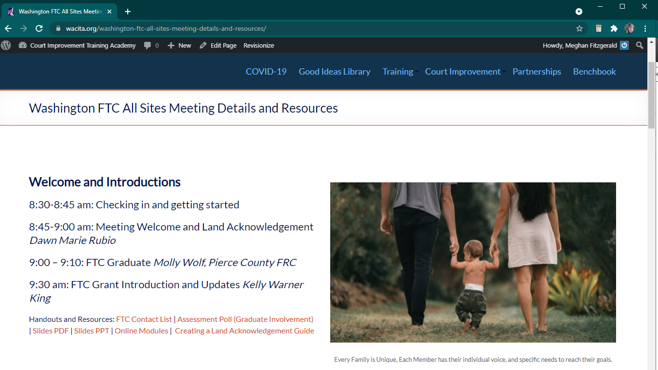
Notes:
Website: https://www.wacita.org/washington-ftc-all-sites-meeting-details-and-resources/

Slide 6
Accessibility and Information Equity Information
We are dedicated to developing training materials with equitable access to information, please give feedback if we can improve!
Transcript and captioning
Accessible handouts available as pdf and editable word documents
All materials are licensed as creative commons attribution – Non Commercial – Share Alike (CC BY_NC_SA 4.0) except logos used by other organizations.

Slide 7
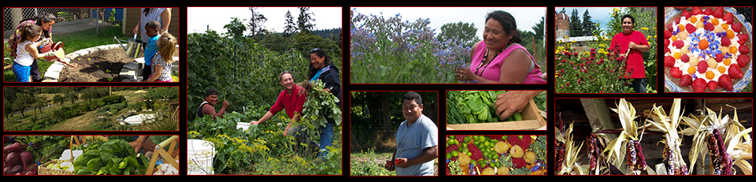
Land Acknowledgement
Photos from the Nisqually Indian Tribe Website
Nisqually Indian Tribe :: Community Garden Program (nisqually-nsn.gov)
We are joining each other today from across Washington State, which was historically home to many tribal communities. Today we would like to honor the land where the Administrative Office of the Courts makes its home in Olympia, WA. The Nisqually tribe lived on the lands from Olympia to portions of Mt Rainer and often gathered for Potlaches with other coastal tribes in the areas to the East and West of Budd Inlet, a favorite area for shellfish gathering and now the city of Olympia’s coastal water access point. We honor the gifts the Land brought to the Nisqually and also honor the Nisqually tribe and the trials that they have gone through since the forced colonization of these ancestral lands. We also give thanks for the tribal members here with us today, and greatly respect the work you are doing to reunite families and to care for your children. We see you, respect your right to sovereignty and self-determination, and are committed to being better listeners, learners, and in lifting indigenous voices. Feel free or use the maps we have placed in the chat to learn more about the tribe in your local area, and share in the chat.
Notes:
http://www.nisqually-nsn.gov/index.php/administration/tribal-services/community-services/community-garden-program/

Slide 8
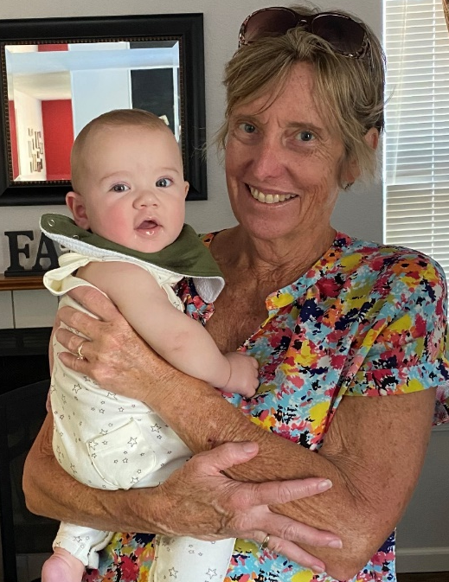
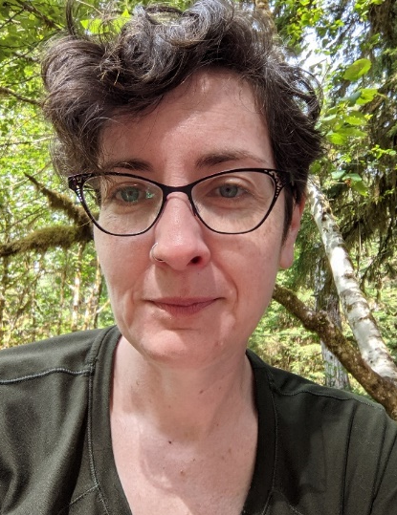
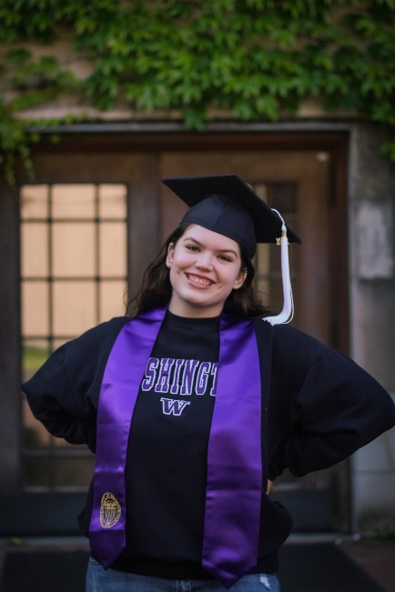
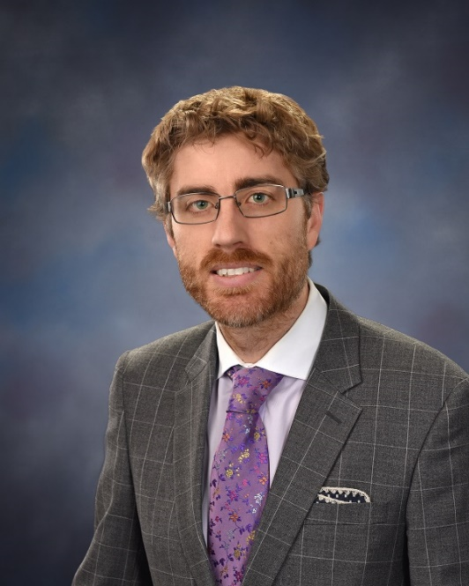
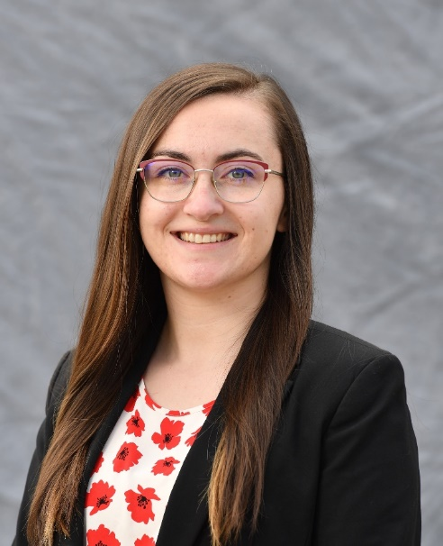
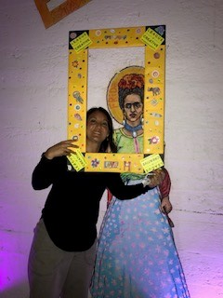
Sharing Our Stories:
Best Practices through Lived Experiences
All Sites Planning Team:

Slide 9
Molly Wolf, Pierce County FRC
Mother of 4 children
Enrolled at Centralia College
Works for Evergreen Treatment Services

Slide 10
Grant Progress
Kelly Warner King
Kelly Warner-King, JD, is the Manager of the Family & Youth Justice Programs at the Administrative Office of the Courts. An attorney with extensive legal and policy experience in child welfare and education, Kelly leads programs that improve court systems to promote thriving families and equitable court communities. Previously, she served as Director of the Court Improvement Training Academy (CITA), where she developed and delivered training for judicial officers and court partners and facilitated interdisciplinary court improvement efforts. Kelly serves on a variety of state-level workgroups to improve the administration of justice in child welfare. Kelly’s experience includes work in the dependency court system as an attorney for parents and children, the manager of the King County Family Treatment Court and the coordinator of the Supporting Early Connections program for the Center for Children & Youth Justice. She was also the first Legal Ombuds in the Washington State Office of the Education Ombuds and worked as an education policy analyst with the RAND Corporation. Kelly received her law degree from New York University, where she focused on juvenile rights and representation, and her undergraduate degree from the University of Virginia
Family & Youth Justice Programs
Transforming systems to promote thriving families and equitable court communities

Slide 11




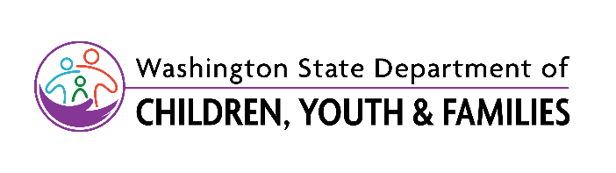
Funding and Partners Acknowledgement
2020-AR-BX-K001
This project is supported by Grant # 2020-AR-BX-K001 awarded by the Office of Juvenile Justice and Delinquency Prevention, Office of Justice Programs, U.S. Department of Justice. The opinions, findings, and conclusions or recommendations expressed in this publication/program/exhibition are those of the author(s) and do not necessarily reflect those of the Department of Justice or our partner organizations.

