Slide 1
May 28, 2020
Virtual Family Time:
Supporting Families & Building Connections
TM

Slide 2
Presenters
Partners for Our Children: Susan Barkan, Kimberlee Shoecraft and Laura Orlando
Fostering Connections for Families: Katie Biron
Parent Representation Program Social Service Worker: Jason Bragg

Slide 3
About Partners for Our Children
Part of the School of Social Work at the University of Washington
Works to improve the lives of vulnerable children and families, especially those touched by the child welfare system
Founded in 2007, Partners for Our Children:
Supports evidence-informed child welfare policies and practice
Advances research and innovation to strengthen the child welfare system
Work in partnership with the public and private sector and with communities to advance healthy child and youth development and prevent the need for system involvement.
Have developed and piloted the Strive Supervised Visitation Program; focused on providing support & education early on for in-person family time

Slide 4
About Fostering Connections for Families
Recognizing the importance of building and maintaining relationships between all the important people in a foster or adopted child’s life, Katie Biron from Fostering Connections for Families offers consulting and interactive workshops for professional staff, foster caregivers and adoptive parents. With a focus on keeping the child at the center of the relationship, Katie helps caregivers and adoptive parents navigate these unique relationships to keep kids connected to their loved ones.

Slide 5
About Jason Bragg
Jason Bragg is a contracted Social Service Worker with the Washington State Office of Public Defense. He has been assisting attorneys, parents and stakeholders in breaking down barriers to help reunify families involved in child welfare. Jason demonstrates his passion for serving families through both personal and professional experience. Jason sits on various committees at the state and local levels. He is a Alumni member of the Washington State Parent Ally Network who over the last 8 years have helped change, advocate and support Legislative work to improve child welfare. He has facilitated Father’s Engagement groups in Seattle Washington for the past 6 years. He is also a Father that has successfully navigated the child welfare system to reunify with his son. In doing that he realized his passion to help others. His passion comes from realizing that as a parent he didn’t deserve another chance to reunify, but that his son did. His son was deserving of the chance his father was given to try one more time.

Slide 6
Today’s webinar…
Share an overview of the Supportive Virtual Family Time Program & why it was developed
Provide video examples of virtual family time with
and without support
Share handouts & resources
Allow you to hear directly from parents and foster parents why support matters right now, more than ever!

Slide 7
Uncertain Times…
Thank you for giving us some of your time today. We know that this is a difficult time for all, especially for those involved in the child welfare system.
We hope to share some encouragement and support to help parents, children and caregivers to keep up the connection, whatever form it may take.

Slide 8
What is the Supportive Virtual Family Time (SVFT) Program?
It is a free program that creates structure, guidance, and training for those supervising virtual parent-child visits with the goal of helping them facilitate positive remote supervised visits between parents and their children in out-of-home care.

Slide 9
Why did we develop this program?
Unprecedented and difficult time for parents, children and caregivers due to Covid-19
In some cases, this is the first time parents and caregivers are meeting; can be awkward and stressful
Family Time supervisors need additional support/skills for this new reality
Positive parent and caregiver relationships = better outcomes for children

Slide 10
How did we develop this program?
Gathered resources and suggestions for activities and resources for virtual family time including guidance developed by the Washington State Department of Children Youth and Families
Developed a curriculum guide; includes guidance for how the family time supervisor can bring the parent and caregiver together for a meeting to prepare for virtual family
We reached out to Katie Biron of Fostering Connections for Families and Jason Bragg of the Parent Representation Program and they generously created video examples
Created an online, self-directed training for family time supervisors (and others involved in the case)
Notes:
1. a positive meeting between the parent and caregiver facilitated by the visit supervisor to meet each other and prepare together for positive virtual visits.
2. how a virtual family time visit can go when the parent and caregiver are working well together.

Slide 11
SVFT Program Model
Better virtual family time for all
Pre- Meeting with parent (30 mins)
Pre-Meeting with caregiver (30 mins)
Family Time Partnership Meeting (1 hour)
Debrief (15 mins individually ) or (30 mins joint)

Slide 12
SVFT Training Model
Part One
Part Two
Training guide with scripts (videos, handouts & resources)
Part Three
1.5 hours of meetings and debrief time
Online training for visit supervisors and/or caseworkers (50 mins)

Slide 13
Bruce Perry, M.D., Ph.D, a specialist in trauma and brain development has spent his career studying how children’s social and emotional brain develops in close relationships. "Emotional contagion” is a term Dr. Perry uses to talk about how adults can regulate or dysregulate others (particularly children) emotionally. An emotionally dysregulated adult will never be able to regulate a child (or another adult). Once an adult or child is emotionally dysregulated they lose access to parts of their brain that help them make good decisions, weigh risks, etc.. Given the situation we are all in, parents and caregivers may have to work extra hard right now to keep themselves emotionally regulated for their children. The Supportive Virtual Family Time program has several aspects that focus on regulation and calming strategies in preparation for virtual visits for parents and children.

Slide 14
Challenges to Virtual Family Time
The following video, which demonstrates some of the current challenges of virtual family time between a parent and children:
https://youtu.be/YCbABT0Yn6s

Slide 17
Virtual Family Time with Support
The following video, shows how using planning and supportive principles from the Supportive Virtual Family Time program can help to address the challenges we saw in the previous video to make the virtual family time more of a positive experience:
https://youtu.be/JfjfmgYysjY

Slide 18
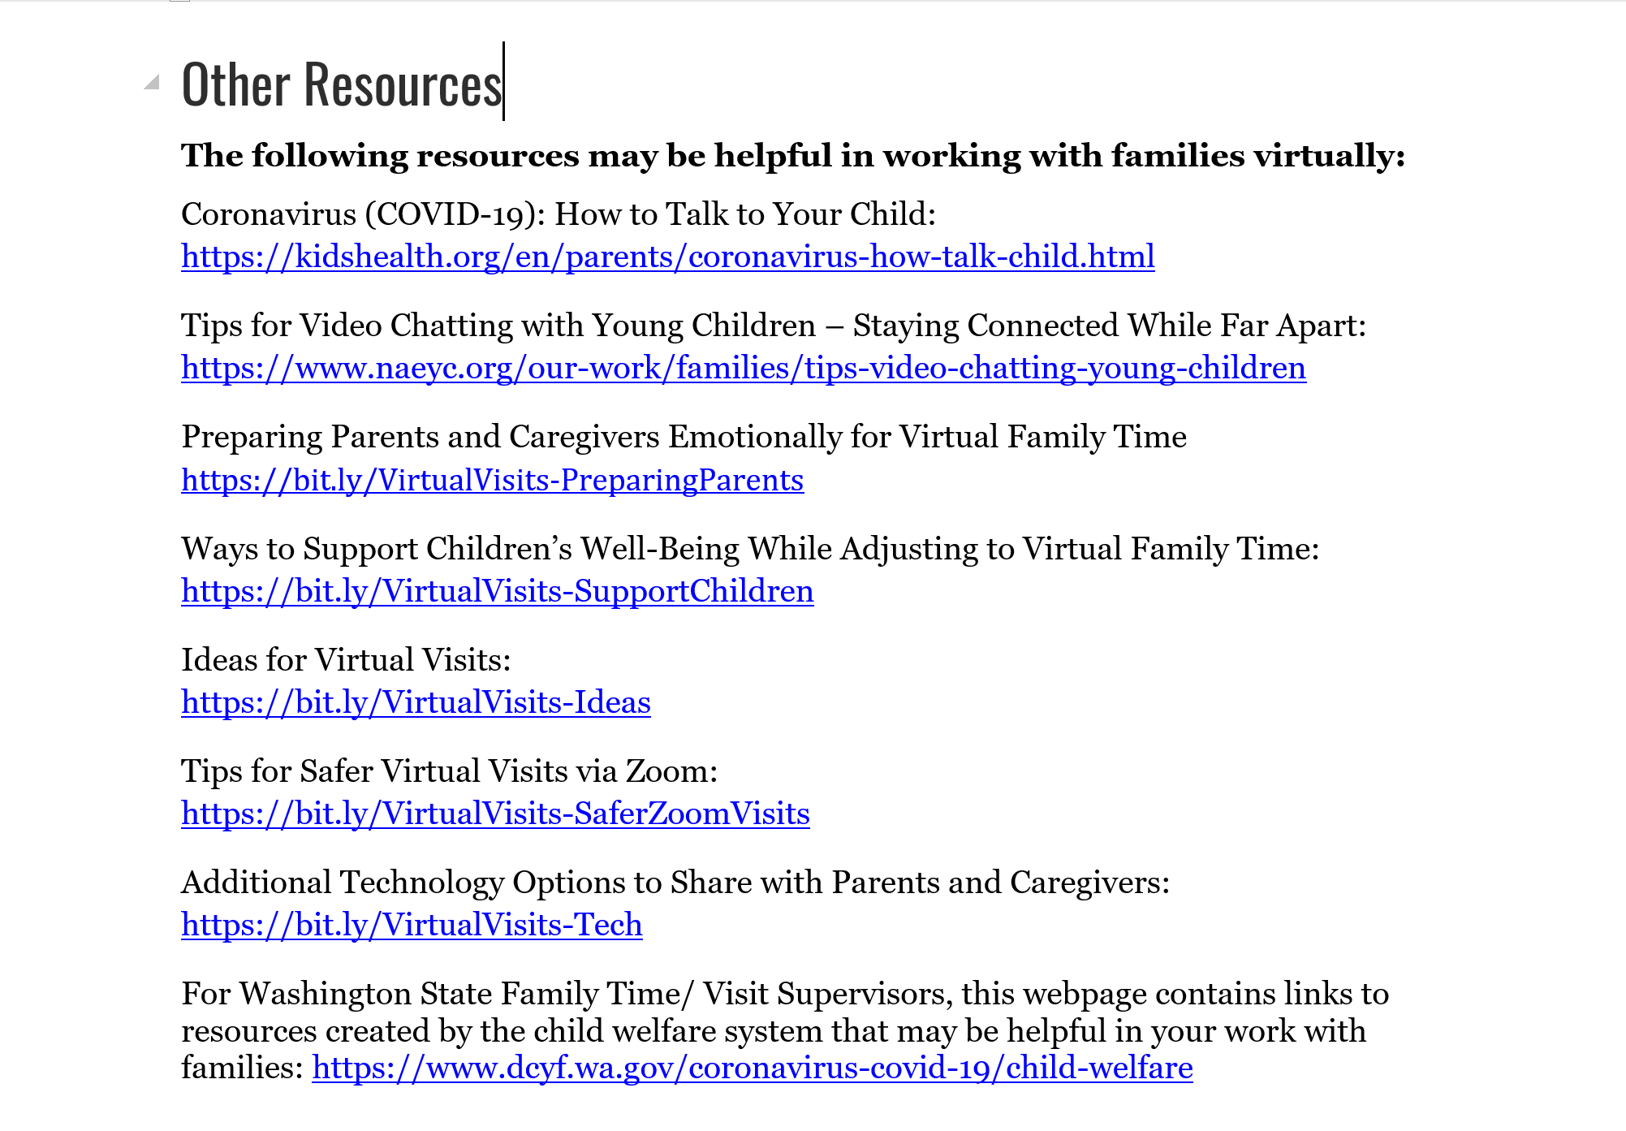

Slide 19
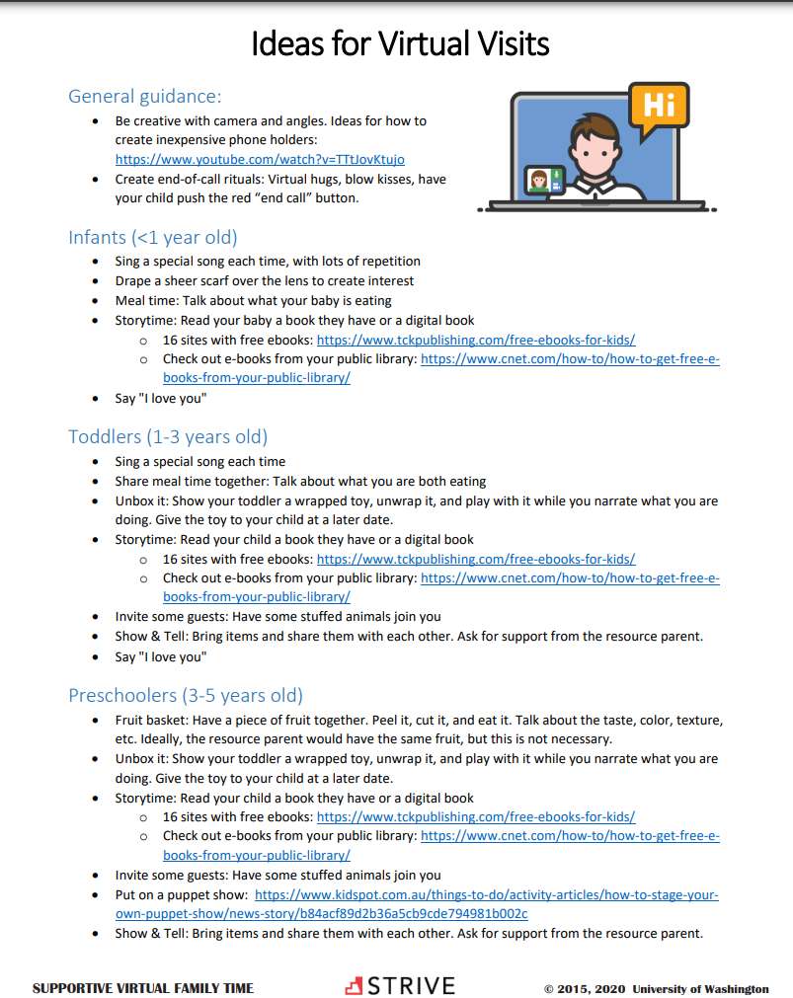
https://bit.ly/VirtualVisits-Ideas

Slide 20
https://bit.ly/VirtualVisits-PreparingParents

Slide 21
How can the program be accessed?
Hosted by:
WA State Alliance
for Child Welfare
Excellence
https://allianceforchildwelfare.org/content/family-time-supportive-virtual-family-time-program-and-training-elearning

Slide 22
Additional information
Meetings are voluntary for parents and caregivers; possible to only deliver part of the program
Accessible for use by all; resources and handouts that can be used by visit supervisors and/or caregivers

Slide 23
15% Solutions

Slide 24
Questions, Comments, Thoughts?

Slide 25
To receive CLE or CJE credits for this webinar, go to: https://www.wacita.org/cita-webinar-connecting-parents-and-caregivers-to-make-virtual-family-time-work-for-everyone/

Slide 26
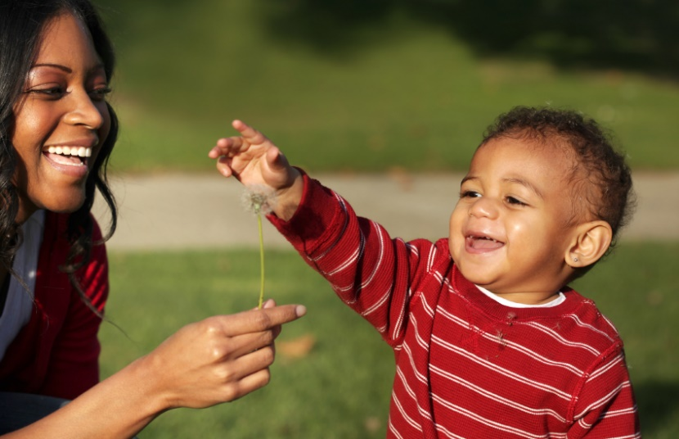
Thank you!
For more info please contact:
Susan Barkan Katie Biron
barkas@uw.edu katiebiron@outlook.com
Laura Orlando Jason Bragg
lorlando@uw.edu Jasonb@parentsrepwa.org
Kimberlee Shoecraft
shoeck@uw.edu
www.striveparenting.org
www.partnersforourchildren.org

