Slide 1
Reasonable Efforts
Commissioner Matt Clucas, Kitsap County
Judge Monty Cobb, Mason County
Notes:
Introduce ourselves
Over 5 years exp in dependency? 1-5 years? Under 1 year?
Who has made a RE finding in the last year?
Who has made a finding of NO RE in the last years

Slide 2
Look Familiar?
Notes:
Clipped paragraph from dependency order

Slide 3
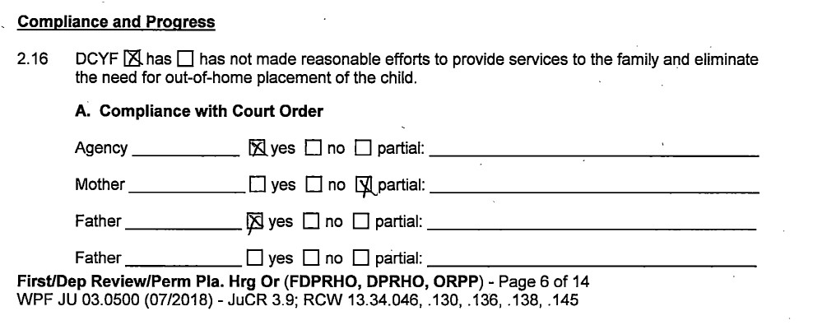
Look Familiar?
Notes:
Clipped paragraph from same dependency order as previous paragraph

Slide 4
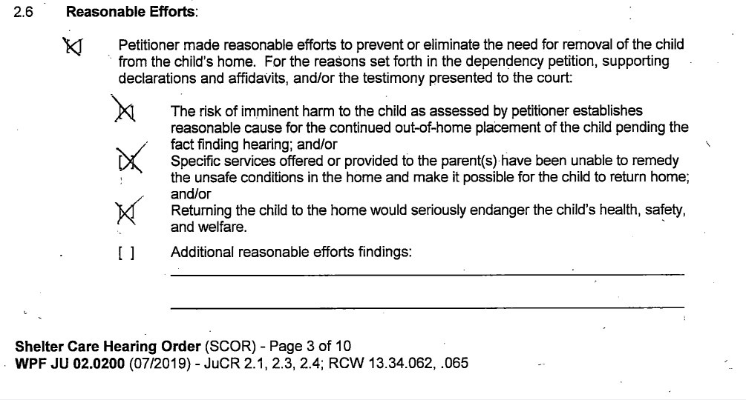
Look Familiar?
Notes:
Clipped paragraph from shelter care order
QUESTION: why do you think findings of NO RE don’t happen more often

Slide 5
Why do you think findings of No Reasonable Efforts are so rare?
The Department does a good job.
The attorneys don’t raise the issue.
Can I even raise the issue of RE if no one brings it up?
A finding of No RE means no IV-E money for the Department and they are short of funds as it is.
The Department is short-staffed doing the best they can.
The social workers are nice people and we all work as a team. I don’t want anyone to be afraid to come to court because …..

Slide 6
Notes:
So why should YOU care about RE?

Slide 7
Reasonable Efforts
Why should I care about RE?
Isn’t that the job of DCYF?

Slide 8
WHY SHOULD I CARE?
RE are required by State and Federal Law (you know, that whole oath of office thingy)
RE are a great companion to the Safety Guide analysis
Money
Behavioral reinforcement
Leverage

Slide 9
WHY SHOULD I CARE?
The responsibility is meant to ensure that the child welfare system is functioning on behalf of children and families in the way that it was designed to function. To that end, among other things, juvenile court judges must evaluate the quantity and quality of services provided to children and families at multiple stages of the process. That evaluation manifests itself through what are called reasonable efforts.
Judge Michael Nash in his Foreword to Reasonable Efforts, A Judicial Perspective by Judge Leonard Edwards.

Slide 10
Reasonable Efforts
History
Statutes and Definitions
RE in practice

Slide 11
History Welcome to the Land of Acronyms
Child Abuse Prevention and Treatment Act (CAPTA)
Indian Child Welfare Act (ICWA)
Adoption Assistance and Child Welfare Act (AACWA)
Adoption and Safe Families Act (ASFA)
Notes:
CAPTA 1974 designed to “save children” ,not reunify families
ICWA 1978 set the active efforts responsibility for native children
AACWA 1980 requires 6 month reviews, permanency hearings and initiates reasonable efforts for removal and reunification
ASFA 1997 added kinship considerations, also requires judges to make findings of RE in permanency. The CFRs that come from AFSA are what require explicit documentation that is case specific.

Slide 12
What are RE?
RCW13.34.025
“services that facilitate the reunification of the child safely and appropriately within a timely fashion”
individual, group, and family counseling
substance abuse, mental health, DV treatment or services;
temporary child care and therapeutic services for families
transportation to or from services and activities
This can also include housing assistance. RCW13.34.130
Notes:
remedial services are those services defined in the federal adoption and safe families act as family reunification services that facilitate the reunification of the child safely and appropriately within a timely fashion. Remedial services include individual, group, and family counseling; substance abuse treatment services; mental health services; assistance to address domestic violence; services designed to provide temporary child care and therapeutic services for families; and transportation to or from any of the above services and activities.

Slide 13
When are RE required?
RCW13.34.110; .130
Reasonable efforts are required to:
1. prevent removal or eliminate the need for removal of the child from the child’s home;
2. make it possible for the child to return home;
3. establish permanency.

Slide 14
When are RE NOT required?
RCW13.34.132
Aggravating circumstances may
eliminate the RE requirement.
Requires clear, cogent and convincing evidence.
Notes:
See 13.34.132 for the list
Also refer to DCYF Policy 4304 on Reasonable efforts for the Departments view

Slide 15
When are RE NOT required?
RCW13.34.132
Aggravating Factors can include:
1. sex offense/assault/trafficking of the child;
2. similar offenses against other family members,
3. sex offense that led to the birth of the child
4. failure to complete a treatment plan that led to a prior termination and no change in the interim.
Notes:
See 13.34.132 for the list
Also refer to DCYF Policy 4304 on Reasonable efforts for the Departments view

Slide 16
RE in practice When are RE findings timely?
Within 60 days of removal
This focuses on efforts to prevent removal
Within 12 months after entry into foster care and every 12 months thereafter
This focuses on the attempts to reunify, and efforts to establish permanency
Notes:
These are driven by 45 CFR 1356(b)(1) the 60 day and (b)(2) the 12 months req.
So, with a review hrg at 6 month and PP hrg at 12 month intervals, when do you need a RE finding? Can you make RE findings more often?

Slide 17
RE in practice Using the Safety Guide as a roadmap
What is the Safety Threat?
What was done prior to removal to address the safety threat?
What services were offered to address the safety threat after removal?

Slide 18
RE in practice Using the Safety Guide as a roadmap
What is the child’s vulnerability to the Safety Threat?
What was done prior to removal to address vulnerability?
What post-removal services were offered to address vulnerability?

Slide 19
RE in practice Using the Safety Guide as a roadmap
Have any protective factors been considered?
Services?
Family options?
Safety plans?
Are there criminal charges or TROs in place?

Slide 20
RE in practice
Timeliness of services and referrals
Adjusting services to meet changing needs?
Cultural appropriateness of services and providers
Efforts at locating relatives or suitable others
Identifying adoptive or other placements
Background checks and home studies
Other Ideas?

Slide 21
RE in practice Preserving your decision
DOCUMENTATION! (Driven by federal rules)
RE findings must be in the Court Order.
RE findings must be specific.
A transcript of the hearing is the only accepted substitute for findings in a court order
Declarations, affidavits, referring to other documents (like the DCYF report or state law) doesn’t cut it
No Nunc pro tunc orders.
Notes:
Driven by federal rules.

Slide 22
RE in practice Preserving your decision
CHECKBOXES ARE EVIL!!! Don’t you agree?

Slide 23
RE in practice What happens if I find no RE?
No RE made prior to removal?
DCYF gets no IV-E foster care support funds for the duration of foster care for that child
No RE made during pendency of case?
DCYF gets no IV-E foster care support funds until a finding of RE is made subsequently
Notes:
Remember that this does not impact all 4-E money, just a portion that goes to support foster care placement.

Slide 24
Everybody’s always pickin’ on me!
Notes:
You may hurt some feelings but in the long run, you will improve the outcomes for the kids we serve.

Slide 25
RE and ICWA
A finding of no Active Efforts has no effect on IV-E funding.
Can you find RE even if you didn’t find AE?

Slide 26
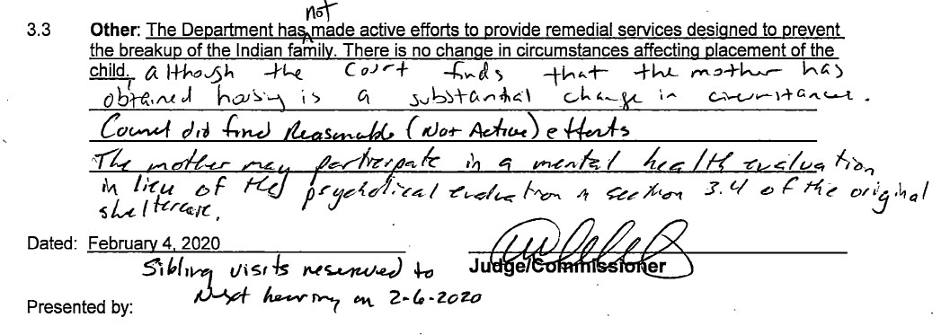
Active vs Reasonable
Notes:
Clipped paragraph from continuing SC Order (contested)

Slide 27
Closing and Questions
Notes:
Don’t forget --- in your mock hearings you will be asked to watch for reasonable efforts

