Slide 1
INDIAN CHILD WELFARE ACT and
2016 FEDERAL REGULATIONS
Stacey Lara
Parent Advocacy Program
Native American Law Center

Slide 2
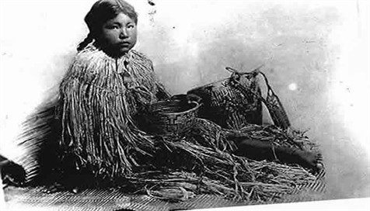
Overview of Discussion
Indian Child Welfare Act history
2016 Federal Regulations

Slide 3
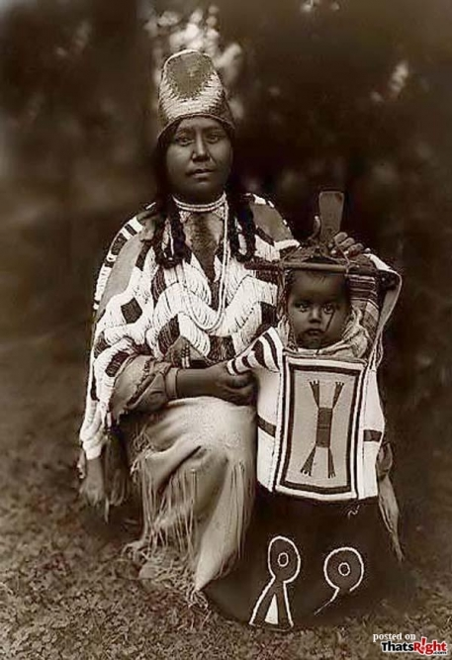
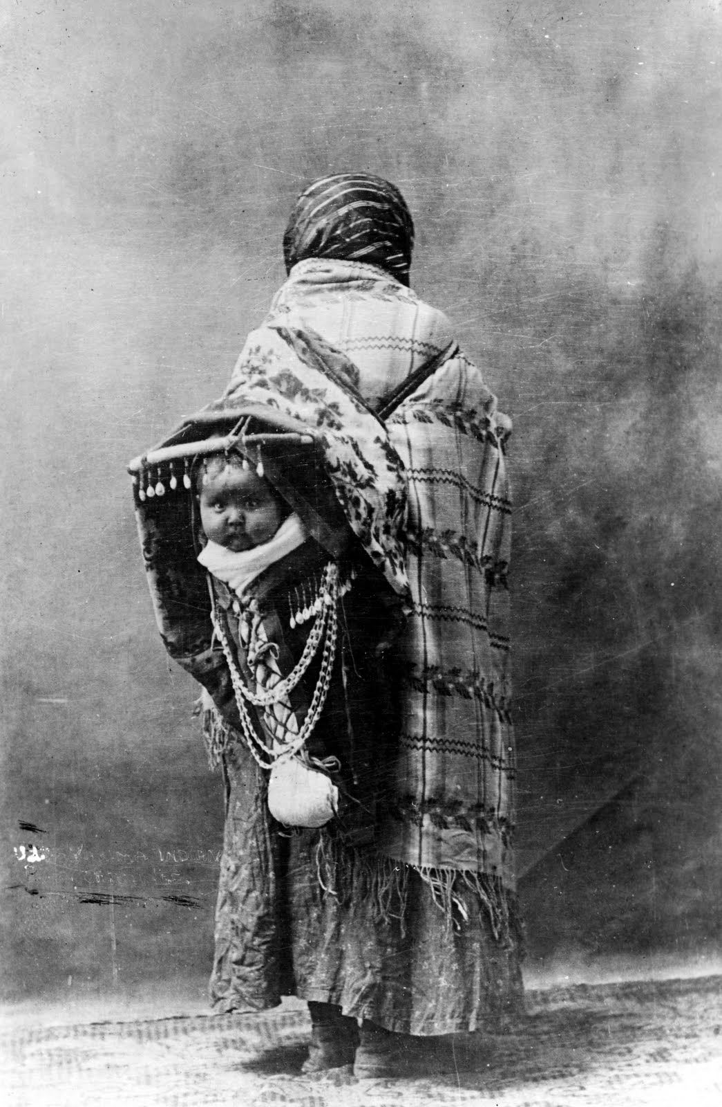
ICWA History
Notes:
The ICWA of 1978 was enacted in response to high percentages of Indian children placed in non-Indian and adoptive homes, and the devastating effect this had on Indian families and communities.
The threat of Indian child removal literally threatened the very existence of some tribes.
Surveys found that in the states with large NA populations, 25-35% of all NA children were removed from their homes and placed in foster care or adoptive homes at one time in their lives.
Across the country, Native kids were separated from their families.
In S Dakota, 40% of all adoptions between 1967-78 were NA kids, but NA kids comprised only 7% of the population.
In WI, risk of NA kids sep from parents 1600% greater than non-NA kids
In Washington, the result of these practices was that the Indian adoption rate was 19 times greater and the FC rate 10 times greater than that for non-Indians.
Indian kids weren’t being removed for abuse, but rather on the grounds of “neglect” or “social deprivation”

Slide 4
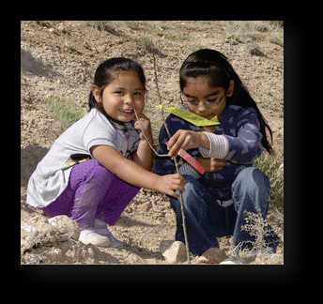
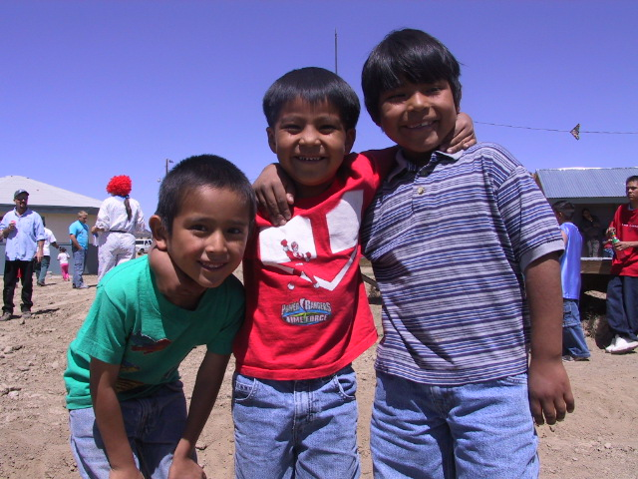
History
Notes:
This neglect often came in the form of parents leaving their children with extended family for periods of time. This practice was commonplace in native communities, and the idea of family might encompass family by marriage or another traditional bond.
IN FACT, one study in N Dakota showed abuse allegations were made in only 1% of cases.
root being SW that didn’t appreciate or value Indian social norms, values and child-rearing practices.
Cultural bias: so many removed because the family didn’t conform to state workers ideas of what a family should be
Due process protections were regularly completely absent. State workers Conditioning welfare benefits for rest of family on parents signing away custody for their children.

Slide 5
ICWA Purpose
The Congress hereby declares that it is the policy of this Nation to protect the best interests of Indian children and to promote the stability and security of Indian tribes and families by the establishment of minimum Federal standards for the removal of Indian children from their families and the placement of such children in foster or adoptive homes which will reflect the unique values of Indian culture, and by providing for assistance to Indian tribes in the operation of child and family service programs.
25 USC§1902 (2006)
Notes:
By 1978, the federal government had moved from an assimilation approach to NA relations to one of self-determination for native americans
Three primary objectives:
Eliminate need to remove Indian kids from families because of cultural bias and ignorance,
Assure that Indian kids that need to be removed for their own protection be placed in homes that reflect their culture and BG;
Encourage tribal court adjudication of child custody proceedings of Indian kids
n tribes.

Slide 6
Safeguards for Indian Children
Protective dual jurisdictional scheme
Mandates to ID Indian children as soon as possible in the case
Higher service provision standards (active vs reasonable efforts) to avoid the breakup of the family
Standards of evidence higher
Placement preferences clearly defined
Right to Intervene and Right to Transfer
QEW testimony

Slide 7
Why the Need for Regulations?
Native kids still disproportionately more likely to be removed from their homes
Inconsistent implementation and interpretation of law across country and even within states
2015 and 2016 Guidelines non-binding
The Heart of ICWA: Becky
Notes:
More than 35 years after the passage of ICWA, the law continues to be a critical and necessary protection for Indian children.
In 2013, NA kids are still represented in FC at 2.5 times their presence in general population.
TODAY, Native kids are still removed at a rate 4x higher than their white peers on their first contact with the court system, with the same or similar allegations (from the BIA handout)
Interpretation has given us a landscape in which judicially created exceptions such as EIF to the application of ICWA for NA families undermines the efficacy of the law’s stated purpose.

Slide 8
Regulations
Citation: 25 C.F.R. 23
Final Rule promulgated June 14, 2016
Took effect December 12, 2016
Available at https://www.gpo.gov/fdsys/pkg/FR-2016-06-14/pdf/2016-13686.pdf
State laws that provide higher protections of the parents control over the regulations. 23.106

Slide 9
Applicability: types of proceedings
Definition of Child Custody Proceedings 23.103
Applies to:
Foster care placements
Guardianships
TPR
Pre-adopt placements
Adoptive placements
Voluntary and involuntary placements where parents can’t get children returned on demand
Custody disputes in which neither parent will get custody
Status offenses
“Custody” and “Continued Custody” 23.103
Domicile: domicile follows the parent or custodian. Court determines domicile 23.110(a)
Notes:
CHILD CUSTODY PROCEEDINGS
The regs provide definitions of each of the four child custody proceedings, including out of home placements for status offenses. Definition does not include voluntary foster care placements where the parent can have their child returned on demand, which is different than previous guidance.
“CUSTODY”
Continued custody includes legal and physical custody or both of parent or custodian as defined under applicable tribal, customary, OR state law.
DOMICILE
Critical to establishing J and how ICWA applies
Applies to:
Foster care placements
Guardianships
TPR
Pre-adopt placements
Adoptive placements
Voluntary and involuntary placements where parents can’t get children returned on demand
Custody disputes in which neither parent will get custody
Status offenses
DOES NOT APPLY TO:
Divorce proceedings or custody disputes between two parents
Juvenile delinquency proceedings
Child custody proceedings do not need to be initiated by a state actor – ICWA applies to private placements and adoptions as well as those initiated by state and county agencies.
ICWA recognizes Tribe’s authority to determine their own membership and state court must defer to that tribal determination of membership.
DOES NOT apply to members of Canada’s First Nations. One court – CA – has held that ICWA provisions regarding release of adoptive records to a person’s tribe applied to Canadian native. P 33 of ICWA handbook. Canadian Tribes can petition court to intervene, can give notice providing the same info as in federally rec tribes.
Existing Indian Family exception – not supported by language of legislation

Slide 10
Applicability: is this an Indian child?
At the earliest stages of contact between Dept and a family, was there an inquiry of each party re whether they know or have reason to know the child is or could be Indian.
At every hearing, every stage of any case, the court must repeat this inquiry of every participant on the record.
What’s a “reason to know”?
  Anyone tells the court the child is an Indian child or there is info indicating the child is Indian
  Domicile of the child or parent/Indian custodian is on a reservation
  Child is or has been a ward of a Tribal court
  Parent or child has ID indicating Tribal membership
Notes:
INDIAN CHILD
Courts must make diligent efforts re determining whether child is Indian until there is confirmation from the child’s Tribe or Tribes that she is not Indian. ICWA must be applied until evidence is presented that satisfies court that child not Indian. Only Tribe can determine “Indian-ness”
parent’s advocates, reach out to child’s tribe, ask to be notified if / when there are any membership enrollment changes to the code. Then run inquiry yourself – could this change impact the child in your case? Doesn’t matter when your child “becomes” Indian – if at any stage he or she does, ICWA applies.
What about a parent’s enrollment status? Since ICWA requires that a parent be enrolled, what is our responsibility to investigate a parent’s enrollment eligibility?
On whiff of potentially Indian child, where parent is not enrolled, is to determine if the parent is eligible for enrollment, get that parent enrolled, and get the Tribe involved.
Finally, during the pendency of a child custody proceeding, it is possible a child’s Indian status will change. Tribes may change the basis upon which they determine their membership, a tribe may gain federal recognition, or new evidence may help a tribe make a more accurate determination.
As of this writing there are 15 tribes whose denial of federal recognition is still on appeal or in litigation, and four tribes whose application for recognition is still pending.
Id. at § 7(4)(a).

Slide 11
Applicability: is this an Indian child?
The court must instruct the parties to inform the court if they subsequently receive information that reason to know the child is an Indian child. 23.107(a)
Unless and until determined not to be Indian child, treat as though is. 23.107(b)(2)
Only Tribe can determine if a child is Indian child. 23.108
Notes:
INDIAN CHILD
Courts must make diligent efforts re determining whether child is Indian until there is confirmation from the child’s Tribe or Tribes that she is not Indian. ICWA must be applied until evidence is presented that satisfies court that child not Indian. Only Tribe can determine “Indian-ness”
parent’s advocates, reach out to child’s tribe, ask to be notified if / when there are any membership enrollment changes to the code. Then run inquiry yourself – could this change impact the child in your case? Doesn’t matter when your child “becomes” Indian – if at any stage he or she does, ICWA applies.
What about a parent’s enrollment status? Since ICWA requires that a parent be enrolled, what is our responsibility to investigate a parent’s enrollment eligibility?
On whiff of potentially Indian child, where parent is not enrolled, is to determine if the parent is eligible for enrollment, get that parent enrolled, and get the Tribe involved.
Finally, during the pendency of a child custody proceeding, it is possible a child’s Indian status will change. Tribes may change the basis upon which they determine their membership, a tribe may gain federal recognition, or new evidence may help a tribe make a more accurate determination.
As of this writing there are 15 tribes whose denial of federal recognition is still on appeal or in litigation, and four tribes whose application for recognition is still pending.
Id. at § 7(4)(a).

Slide 12
Notice 23.111
In any involuntary proceeding in a State court where the court knows or has reason to know that an Indian child is involved, and where the identity and location of the child’s parent or Indian custodian or Tribe is known, the party seeking the foster-care placement of, or termination of parental rights to, an Indian child must directly notify the parents, the Indian custodians, and the child’s Tribe by registered or certified mail with return receipt requested, of the pending child-custody proceedings and their right of intervention.
Notes:
Notice must include: name of child, tribal affiliation if known, a copy of the petition, name of petitioner and atty, statement informing party of right to intervene, statement of RTC, statement that have 20 days to prepare, contact info for court, statement of right to request transfer, potential legal consequences of finding of dependency, statement of child’s right to confidentiality.
Notice contents must be clear and understandable!

Slide 13
Notice (cont’d)
For child-custody proceedings in Washington, notices must be sent to:
Portland Regional Director, Bureau of Indian Affairs
911 NE 11th Avenue, Portland, Oregon 97232
Failure to provide proper notice is grounds to invalidate the court’s action.
25 USC 1914
Notes:
decisions that are made in full compliance with the ICWA provide the greatest assurance of finality

Slide 14
Tribe’s Right to Intervene
The child’s Tribe has an
absolute right to intervene in the case

Slide 15
Transfer to Tribal Court 23.115-119
Request for Transfer must be made orally on the record in court, or in writing by the parent, custodian, or the child’s Tribe
Right to transfer is available at any stage of the proceedings 23.115(b)
Courts must transfer unless parent objects, tribal court declines transfer, or good cause exists not to. 23.117.
Courts cannot consider whether the proceedings are at an advanced stage when the petitioned didn’t get notice until advanced stage; whether transfer was requested previously; whether transfer could impact child’s placement; child’s cultural connections to Tribe; socioeconomic conditions or perceptions of the tribal/BIA social services/judicial body. 23.118
Notes:
Guidelines give some examples of what might be found to be good cause, including advanced stage, child’s objection to transfer
ICWA recognizes that Tribes themselves have an independent interest in any proceeding involving an Indian child. ICWA grants absolute right to intervene, as well as right to request transfer. To exercise, have to know about it in timely way.
RIGHT TO INTERVENE. ICWA grants parents, custodian, and tribe absolute right to intervene at any stage of foster are placement or TPR proceeding. Not limited to involuntary actions. NO timeliness requirement on intervention – may choose not to intervene when given initial notice, but choose instead to do at later stage of case. Once a tribe intervenes, they are a party to the case, entitled to receive service of all pleadings.
RIGHT TO COUNSEL. Mandates state to appoint counsel in “removal, placement and termination proceedings”. May appoint for child but is not mandatory. Applies to private party actions as well, such as stepparent adoptions and private guardianships. Can apply to Interior for fees paid to court appointed lawyers. 25 CFR 23.13
Moving along to dispositions….

Slide 16
Initial Inquiry – Active Efforts
Active efforts means affirmative, active, thorough, and timely efforts intended primarily to maintain or reunite an Indian child with his or her family. 23.2
Definition emphasizes using culturally appropriate services and working with the child’s Tribe to provide services
Prior to ordering involuntary FC placement or TPR, court must conclude that active efforts have been made to prevent the breakup of the family and that they have been unsuccessful. 23.120(a)
Active efforts must be documented in court record before requesting foster care or TPR 23.120(b)
Notes:
Regs include 11 examples of active efforts, emphasizing the engagement of families in accessing services (§ 23.2 Definitions)
Where an agency is involved in the child-custody proceeding, active efforts must involve assisting the parent or parents or Indian custodian through the steps of a case plan and with accessing or developing the resources necessary to satisfy the case plan. To the maximum extent possible, active efforts should be provided in a manner consistent with the prevailing social and cultural conditions and way of life of the Indian child’s Tribe and should be conducted in partnership with the Indian child and the Indian child’s parents, extended family members, Indian custodians, and Tribe. Active efforts are to be tailored to the facts and circumstances of the case
Active efforts must be undertaken at every stage of case, beginning at investigation and before a decision is made to place the child out of home

Slide 17
Standards of Evidence
To place Indian child in FC, C&C evidence must be presented, supported by QEW that continued custody likely to result in serious emotional or physical damage to child. 23.121(a)
TPR requires evidence beyond a reasonable doubt + QEW that continued custody likely to result in serious emotional or physical damage to child. 23.121(b)
Evidence must show causal relationship between the particular conditions in the home and the likelihood that continued custody will result in serious emotional or physical damage to the child. 23.121(c)
Notes:
Showing that a family lives in poverty or using age of custodian without demonstrating causal relationship to harm is unacceptable
------
STANDARDS OF PROOF. Remember that requirements of ICWA are not mutually exclusive of requirements set out by state or federal law and applicable to child custody proceedings but instead are inclusive of those other requirements
To put child in Foster care: party seeking FC of Indian child must show 1) ACTIVE EFFORTS to provide remedial services to prevent the breakup of the Indian Family and 2) C&C evidence with support of qualified expert re that the continued custody of the child by parent or custodian is likely to result in serious emotional or physical damage to child.
Qualified Expert Testimony. Should have specific knowledge of the child’s tribe’s culture and customs.
A member of the child’s tribe who is recognized by the tribal community as knowledgeable in customs as they pertain to family org and child rearing
An expert with substantial experience in delivery of child and fam services to Native families and extensive knowledge of child rearing within that tribe
Professional person having substantial education and experience in his or her specialty area along with substantial knowledge of social and cultural standards of child rearing in the community
TPR. Petitioning party must establish BRD that the continued custody of the parents or Indian custodian would result in the serious emotional or physical harm of the child, which must be supported by qualified expert testimony. Pet party must also show that remedial active efforts have been made to avoid breakup of Indian family.

Slide 18
Qualified Expert Witnesses 23.122
QEW must be able to testify that parent’s continued custody of child is likely to result in serious emotional or physical damage to child
QEW must be able to testify re prevailing cultural and social standards of the child’s Indian tribe
Tribes may designate QEW
Assigned agency social worker may not serve as QEW. 23.122(c)
Notes:
Who can qualify is still pretty vague, but can’t be reg assigned CW.

Slide 19
Emergency Proceedings 23.113
Emergency proceeding means and includes any court action that involves an emergency removal or emergency placement of an Indian child.
Are only authorized to protect child in imminent physical damage or harm, but should cease immediately when the placement is no longer necessary to prevent harm. 23.113(b)(1)
Can be terminated by initiation of child custody proceeding subject to ICWA; transfer of case to Tribe; or Return home
Emergency removals should not last longer than 30 days unless court has made findings pursuant to 23.113(10)(e)
Notes:
State court must make a finding on the record that emergency placement necessary, and revisit with a hearing whenever new info becomes available.
To extend past 30 days, court must make findings that restoring child to parent would subject to imminent phys damage or harm; unable to transfer; AND impossible to initiate “child custody proceeding”

Slide 20
What if a party alleges improper removal?
If a party asserts that a child was improperly removed from a parent or Indian custodian’s care, the court must expeditiously determine whether removal was improper
If court determines that there was an improper removal, the court must terminate the proceeding and return the child to the parent or Indian custodian, unless doing so would subject the child to substantial and immediate danger.
23.114

Slide 21
Voluntary Proceedings 23.124-128
“Voluntary” means either parent, both parents, or the Indian custodian has consented to the placement or the TPR
  Of their free will
  Without threat of removal by state
Parent must be able to have child returned to them “Upon demand”, without any contingencies.
Notes:
Upon demand can be verbal – no formalities necessary
If there is a reason to believe the child is Indian child, take all reasonable steps to verify child’s status with the Tribe.
Placemen

Slide 22
Voluntary Proceedings 23.124-128
Inquiry + Verify: is this an “Indian child”
Placement preferences in 23.129-132 must be complied with
Parental Consent Requirements:
  In writing and recorded by court with jurisdiction
  Not valid if prior to or within 10 days after birth of child
  Court must explain terms and consequences of consent and certify the parent understood
Parent / Indian custodian may withdraw consent to:
  Voluntary FC at any time
  Voluntary TPR at any time prior to entry of final TPR decree
  Voluntary adoption any time prior to entry of final adoption decree
Notes:
If there is a reason to believe the child is Indian child, take all reasonable steps to verify child’s status with the Tribe.
Placemen

Slide 23
Placement Preferences in FC or pre-adopt placements 23.131
Statutory preferences apply in any foster care, pre-adoptive, and adoptive placement of Indian child, unless good cause exists or child’s Tribe has a different placement preference order 23.131(c)

Slide 24
Placement Preferences in FC or pre-adopt placements 23.131
Indian child must be placed in least-restrictive setting that:
Most approximates a family, taking into consideration sibling attachment;
Allows special needs to be met; AND
Is in reasonable proximity to child’s home, extended family, or siblings.
If the child’s Tribe does not have different order of preference, preference must be given in descending order:
Member of child’s extended family;
Foster home that is licensed, approved or specified by Tribe;
Indian foster home licensed/approved by non-Indian authority;
Institution for children approved by Tribe
Notes:
If child’s tribe has est by resolution a diff order of preference than specified in ICWA, Tribe’s placement preferences apply so long as it is least restrictive setting appropriate to child’s needs.
Where appropriate, Court must also consider the the pref of the Indian child and parent.

Slide 25
Good Cause to Deviate from
Placement Preferences
What is good cause? 23.132
Party seeking deviation must state on the record in court or in writing the reason for that request. Bears burden to show by C&C evidence that good cause exists. 23.132(b)
Court’s determination of good cause must be made on record or in writing 23.132(c)
    Indian Foster Home – at least one foster parent must be an Indian person as defined under ICWA
Notes:
Good cause may be based on:
Request of one or both of parents after reviewed ICWA preference options
Request of child if of sufficient age and capacity to understand decision
Presence of sibling attachment that can only be maintained through a particular placement
Extraordinary physical, mental, or emotional needs of child
Unavailability of suitable placement after diligent search, when “suitable placement” conforms to social and cultural standards of Tribe
Placement may not be based on socio-econ status of one placement over another or ordinary bonding that occurred over the life of the non-compliant placement.

Slide 26
Invalidating actions for ICWA violations 23.137
An Indian child, parent, Indian custodian, and the child’s Tribe can all petition to invalidate an action for foster care placement or TPR under state law where it is alleged that ICWA 1911, 1912, or 1913 have been violated. Petitioner does not have to show that their rights were violated – only that there were violations of the law
Upon that petition, court must determine whether appropriate to invalidate action

Slide 27
To Learn More
National Indian Child Welfare Association: nicwa.org
BIA ICWA page: bia.gov
Heart of ICWA YouTube channel
Turtle Talk: turtletalk.wordpress.com
Capacity Building Collaborative and Center for States: capacity.childwelfare.gov
Stacey Lara
(206) 685-3253
slara@uw.edu

