Slide 1


Evolve Leadership
to Promote Justice
in Child Welfare
Introduction to the ABA Safety Guide for Judges and Lawyers
____________
A Practical Learning Experience

Slide 2
Child
Safety Framework
A
Structure for
Decision-
Making
In
Dependency
Court
Notes:
Introduction:
1. Our Intention: Help legal professionals participate in safety assessments and safety planning early in a case, toward the goal of quickly setting up the family for success.
2. Orientation of the Safety Guide is toward reunification - failure to make timely progress based on Safety information would result in non-reunification.
Learn-a-little, practice-a-little.
Safety Guide is inherently practical – not designed to determine outcomes, but describe process for reaching decisions.
Information gathering for Safety Decision-making is foundation. Six core questions:
Who do I need information from?
What is the nature and extent of the alleged maltreatment?
What are the circumstances surrounding the maltreatment?
How does the child function on a daily basis?
How is the child disciplined in the home?
What are the overall parenting practices like in the home?
How are the parents functioning outside their role as parent?
Child Safety: A Guide for Judges and Attorneys: http://www.americanbar.org/content/dam/aba/administrative/child_law/ChildSafetyGuide.authcheckdam.pdf
*Note: Benchcards are not included with the version downloaded from the website, as they are with the Booklet one can order for approximately $20 from the ABA.

Slide 3

9 Why’s:
Finding Clarity and Purpose…
Why do you work in the child welfare court system?

Slide 4

Safety Assessment
Gathering Information
Foundation for case analysis
Safety Plans
Based on Safety Assessment
In-Home
Out-of-Home
Conditions for Return
Based on Safety Assessment
Foundation for Case Plan
Case Plan
Based on Safety Assessment
Eliminates Threats or Enhances Protective Capacity
Progress, Reunification, Dismissal
Judged against Safety Assessment
Reunification ≠ Dismissal
Notes:
By Brocken Inaglory (Own work) [CC BY-SA 3.0 (http://creativecommons.org/licenses/by-sa/3.0) or GFDL (http://www.gnu.org/copyleft/fdl.html)], via Wikimedia Commons

Slide 5
Threats
Are there sufficient protective capacities to protect from threats to which the child is vulnerable?
Vulnerabilities
Protective Capacities
RCW 13.34.065: Shelter care—Hearing—Recommendation as to further need—Release.
WA Children’s Admin Practice and Procedure Manual: 1120 Safety Assessments
Notes:
RCW 13.34.065 (5):
(5)(a) The court shall release a child alleged to be dependent to the care, custody, and control of the child's parent, guardian, or legal custodian unless the court finds there is reasonable cause to believe that:
After consideration of the specific services that have been provided, reasonable efforts have been made to prevent or eliminate the need for removal of the child from the child's home and to make it possible for the child to return home; and
(ii)(A) The child has no parent, guardian, or legal custodian to provide supervision and care for such child; or
(B) The release of such child would present a serious threat of substantial harm to such child, notwithstanding an order entered pursuant to RCW 26.44.063; or
(C) The parent, guardian, or custodian to whom the child could be released has been charged with violating RCW9A.40.060 or 9A.40.070.
CA-PPM: 1120 Safety Assessments
Purpose Statement
Safety Assessment is used throughout the life of the case to identify impending danger and determine whether a child is safe or unsafe. It is based on comprehensive information gathered about the family at the time the safety assessment is completed.

Slide 6
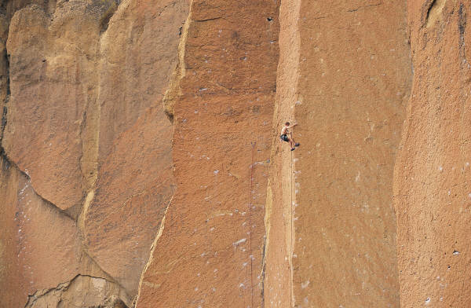
Threats
Specific and Observable
Out of Control
Immediate or Liable
to Happen Soon
Severe Consequences
Notes:
Threats –
Specific and Observable
Out of Control
Immediate or Liable to Happen Soon
Severe Consequences
CA-PPM 1110 Present Danger
Purpose Statement
Present danger can occur at anytime throughout the life of a case and must be assessed on a continual basis. A determination must be made if immediate protective actions are necessary to protect a child and the level of intervention required to keep the child safe.
Policy
Assess if present danger exists during any contact with a child to determine if an immediate, significant and clearly observable behavior or situation is actively occurring and is threatening or dangerous to a child.
When present danger exists, identify and take immediate protective action(s) necessary to create child safety.

Slide 7
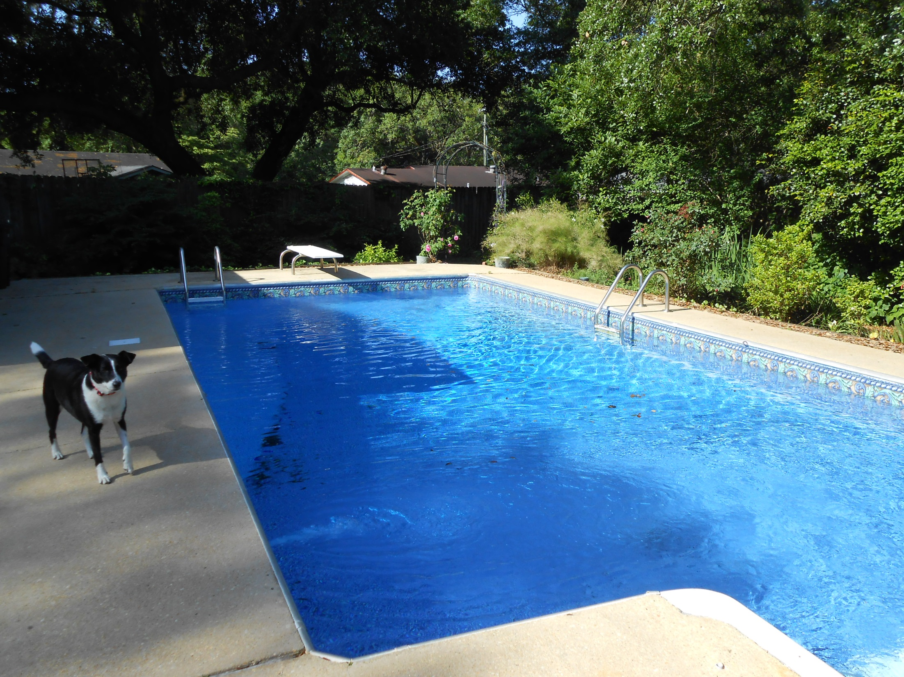
Vulnerabilities
Child Specific
Vulnerable or Not, Not Judged in Degrees
If Threat Exists, Presume Vulnerability
Notes:
Vulnerabilities-
Child Specific
Vulnerable or Not? Not Judged in Degree.
If Threats Exist, Presume Vulnerability
Capacity to Self-Protect (Not call 911, but avoid Threat)
Age of Child
Physical or Mental (Dis)Abilities
Connection or Isolation in Community
Child’s Ability to Judge or Anticipate Danger
Emotional Vulnerability or Maturity
Impact of Prior Maltreatment
Feelings Toward Parent – attachment, fear, insecurity or security
Ability to Articulate Problems and Danger
By Marquerite Dillon (Own work) [CC BY-SA 4.0 (http://creativecommons.org/licenses/by-sa/4.0)], via Wikimedia Commons

Slide 8

Protective Capacity
Cognitive
Behavioral
Emotional
Notes:
Protective Capacity-
Cognitive – Does parent express understanding of threats and role of protector?
Behavioral – Does parent behave according to their understanding?
Emotional – Does the parent have empathy for the child’s situation, and are they motivated to act on perceptions and understanding about threats?

Slide 9
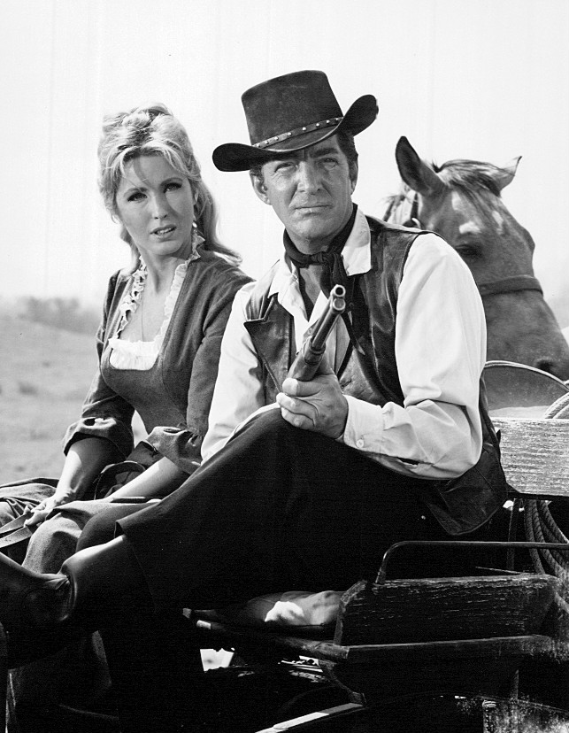
Threat or No Threat?
Specific and Observable
Out of Control
Immediate or Liable to Happen Soon
Severe Consequences
Notes:
Threat – No Threat - Use Safety Framework Components Handout
16 year old Margo is left at home alone in the evening while her mother works the night shift. (N)
7 year old Lily lives in a home that is extremely “dirty” – garbage has not been taken out in weeks, rotting food on the counter, cat feces on rug, many exits blocked with “junk”. (T)
Mother is arrested for dealing methamphetamine out of home. (T)
Police have arrested mother’s boyfriend on numerous occasions for Domestic Violence. Mother has had to go to the hospital on at least one occasion for stitches as a result of an incident the child witnessed. Mother is currently at DV shelter with child. (N)
Mother is “chronic alcoholic” and often drinks to the point of passing out while attending 5 year old son. No other caregivers are in the home when this occurs. (T)
14 year old son has announced to family that he is “Gay” parents often refer to him in extremely negative terms and have isolated him from the rest of the family (i.e. seperate sleeping, eating, and no contact with siblings) until he can be “cured”. (T)
7 year old child is in a home which regularly only has peanut butter, bread, and Top Ramen to eat. (N)
Mother indicates her 16 year old daughter is out of control because she repeatedly sneaks out of the house at night to go with 19 year old boyfriend. She is requesting placement. (T)
Mother has called concerned because father intends to give “boxing lessons” in back yard to 7 year old boy who is being bullied at school. Mother reports last time father did this, child had 2 black eyes and stitched lip. (T)
Father of 17 year old girl has been arrested on suspicion of sexually abusing her. He has been released with a no contact order. Mother has indicated she will not let father back into home with daughter. (N)
8 year old child is sent to office at school for fighting. Child seems extremely fearful to call home as directed by principle because he says he will “get a whoopin’” (T)

Slide 10
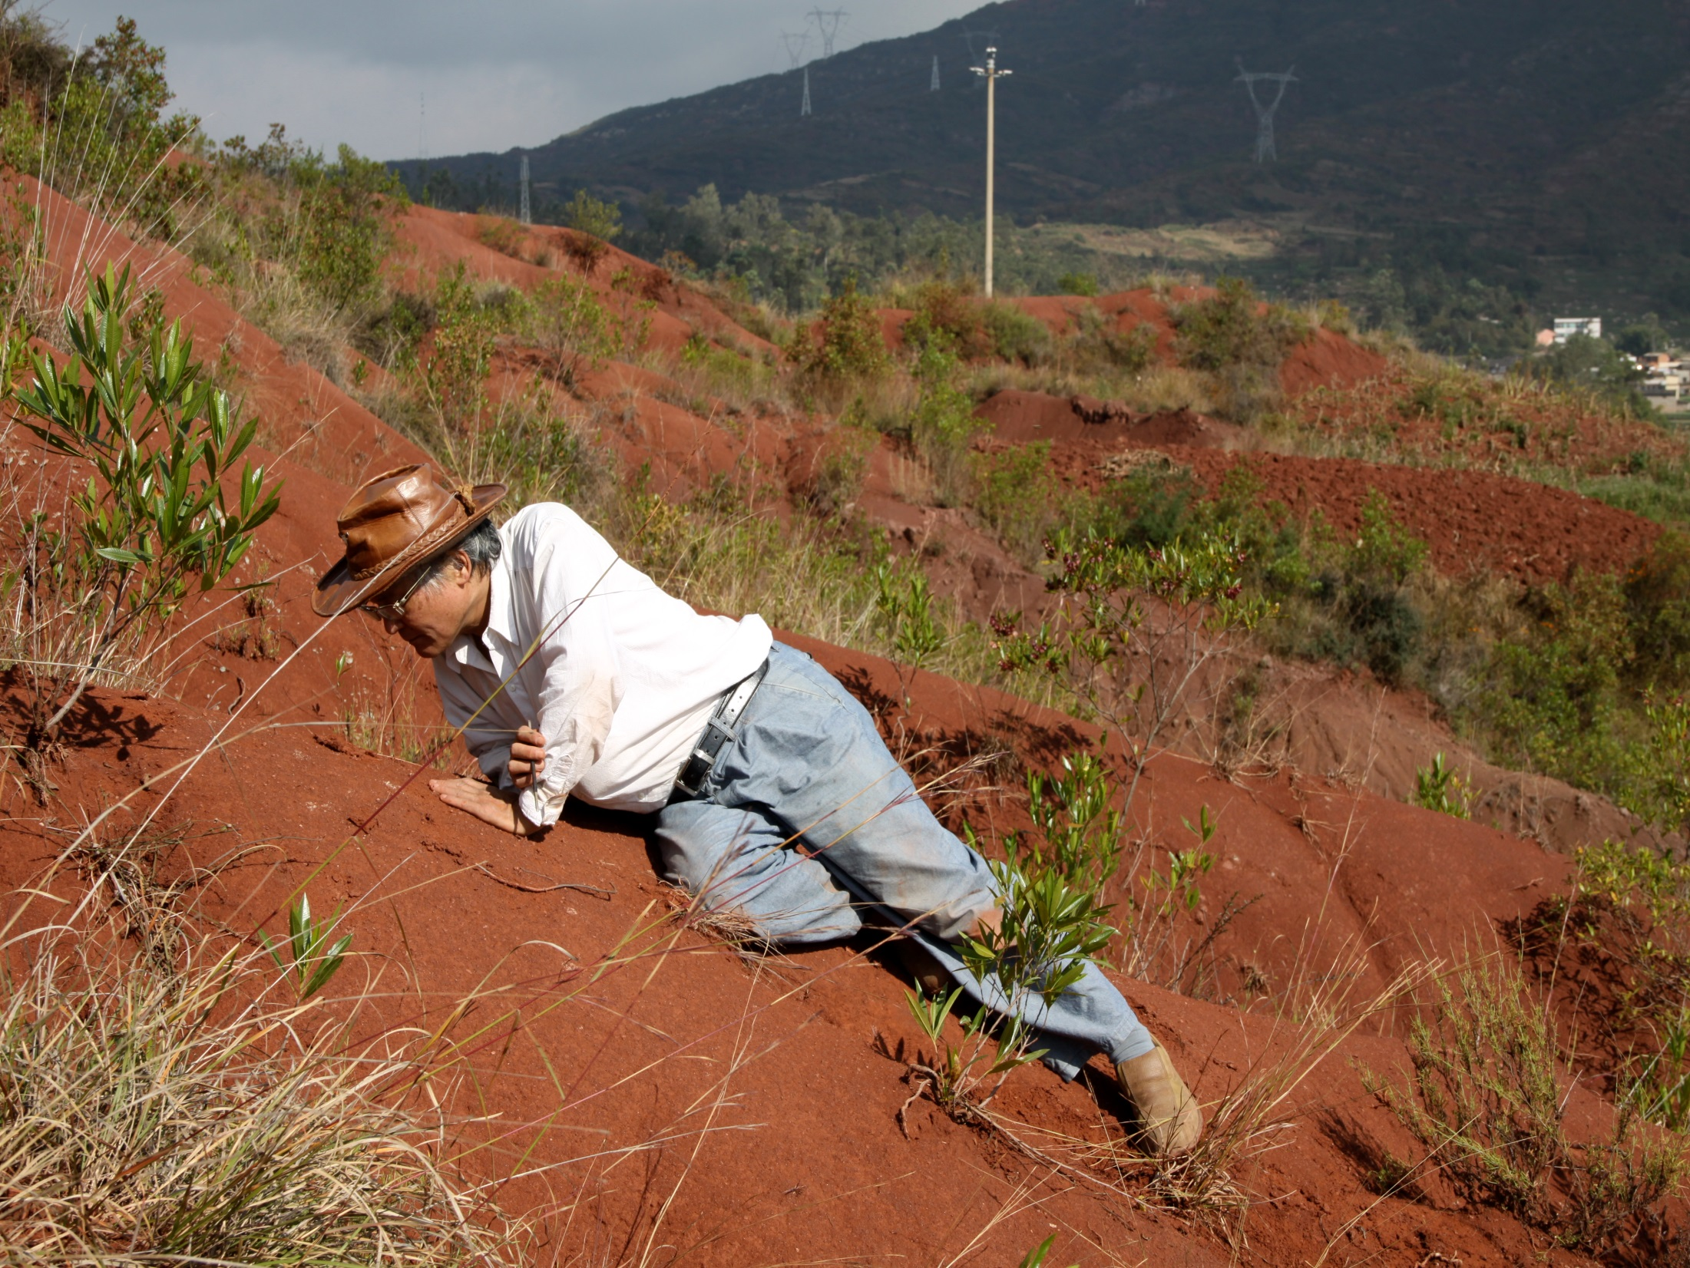
The Judge Expects Information
Notes:
Use Safety Assessment handout - 1.2.4.All
Six Questions from Chapt. 2
What is the nature and extent of the maltreatment?
What circumstances accompany the maltreatment?
How does the child function day-to-day?
How does the parent discipline the child?
What are overall parenting practices?
How does the parent manage his/her own life?
By Timothy Huang (Own work) [CC BY-SA 3.0 (http://creativecommons.org/licenses/by-sa/3.0)], via Wikimedia Commons

Slide 11
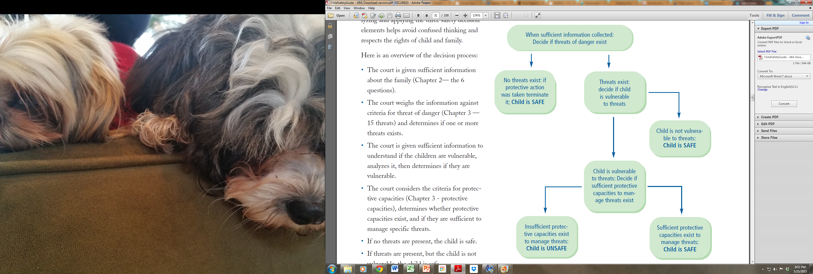

Slide 12
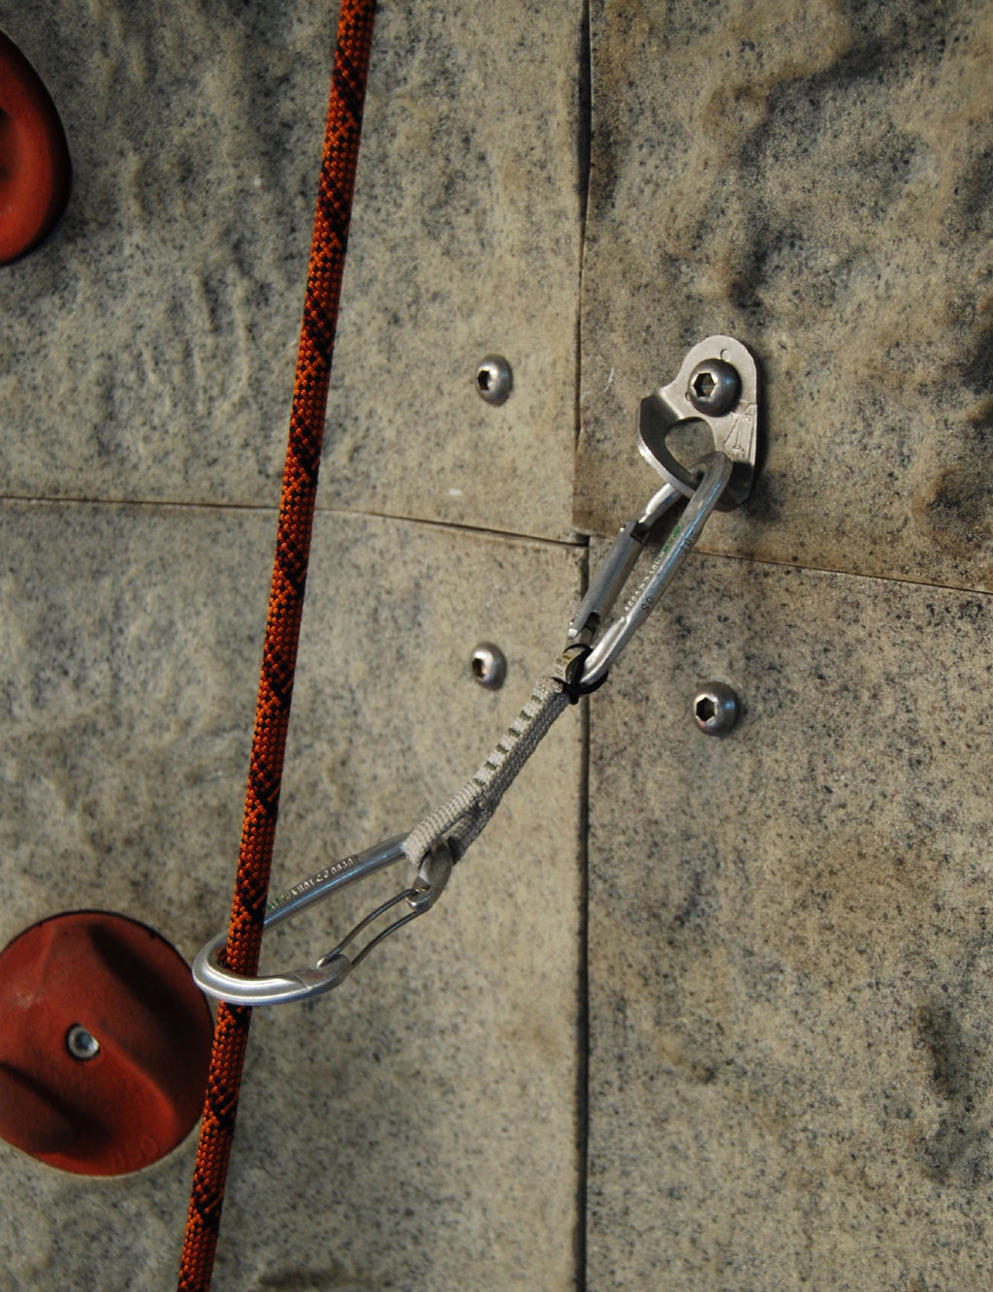
Safety Planning
Does not require change in parents behavior or attitude
Controls threats – immediately
---------------------------------------------
Sufficient
Feasible
Sustainable
---------------------------------------------
Assessing Reasonable Efforts
  Actions or Services to Control or Manage Threats
Notes:
Safety Planning is not Case Planning.
Case Planning is focused on underlying Cognitive, Behavioral, or Attitude changes needed to control or eliminate threats without Court oversight.
Safety Planning is focused on controlling threats necessary for children to be in the home.
Does not require change or promise of change from parent.
Immediate effect of controlling threats
Sufficient, Feasible, Sustainable
Questions In-Home Safety Plans should answer include…
How do threats emerge?
Can it be controlled?
Can someone substitute for parent in home as protective factor?
REASONABLE EFFORTS TO ENABLE SAFETY PLAN MIGHT INCLUDE:
Actions or services to control or Manage Threatening Behavior
In-home health care
Supervision or monitoring
Stress reduction
Out-patient or in-patient medial treatment
Substance abuse intervention, detox
Emergency medical care
Emergency mental health care
Actions or services that will Manage a Crisis
Crisis Intervention
Counseling
Resource acquisition, obtaining financial help; help with basic parenting tasks.
Actions or Services Providing Social Support
Friendly visitor
Basic parenting assistance and teaching
Homemaker services
Home management
Supervision and monitoring
Social support
In-home babysitting
Actions or Services that Briefly Separate Parent and Child
Planned parental absence from the house
Respite care
Daycare
After school care
Planned activities for the children
Short term out-of-home placement of child; weekends; several days; few weeks
Actions or Services to Provide Resources
Resource acquisition, obtaining financial help, help with basic needs
Transportation services
Employment assistance
Housing assistance
Gohnarch at the German language Wikipedia [GFDL (http://www.gnu.org/copyleft/fdl.html) or CC-BY-SA-3.0 (http://creativecommons.org/licenses/by-sa/3.0/)], via Wikimedia Commons

Slide 13
Safety Planning
Out-of Home Plan
Assessing Reasonable Efforts
Conditions for Return - Clearly
  Value Congruence
  Behavior/Circumstance-Based Language
Kind and Amount of Parent-Child contact.
Notes:
Safety Planning is not Case Planning.
Out-of-Home
Assessing Reasonable Efforts
Manage threatening behavior
Manage Crisis
Provide social support
Brief separation of parent/child (i.e. weekends, evenings, etc)
Provide Resources
Out-of-Home Safety Plan
Based on Safety Framework
Clarity of Language – In Order
Confusion reduces likelihood of reunification
Behavior- and Circumstance-Based Language
Not based on compliance with services
Conditions for return of the child to the home.
Acceptable people, behavior, circumstances
In place and active
Always include the parent’s agreement to court-ordered in-home safety plan
Kind and Amount of Parent-Child contact. (On next slide)
A note about Reasonable Efforts – Two Kinds
Reasonable Efforts to prevent removal or immediately return
Must be made within 60 days – ASFA
Condition of removal from beginning – WA State law
Reasonable Efforts to Finalize a Permanent Plan
Must be made by 12 months – ASFA
May be made at any time
Must be made at ALL review hearings - WA State law
Note: After identification of Out-of-Home Safety Plan, failure of the department to make efforts to implement the plan can be used to assess whether Reasonable Efforts to achieve permanent plan were made. State cannot draw down Title IV-E funds while “no reasonable efforts” finding is in effect in a case.
Gohnarch at the German language Wikipedia [GFDL (http://www.gnu.org/copyleft/fdl.html) or CC-BY-SA-3.0 (http://creativecommons.org/licenses/by-sa/3.0/)], via Wikimedia Commons

Slide 14

Case Planning
Use Safety Framework to design case plan.
Looking toward the Court and Dept exiting Family.
Usually requires changing in parental behavior
RCW 13.34.136 Permanency Plan of Care
CA-PPM 1140 Family Assessment…
Notes:
Increase the Case Plan’s Likelihood of Success.
Behavior and Attitude changes required – not just compliance.
Does the Plan follow from the threats?
Different from Safety Plan?
Address underlying issues (Poverty or Trauma)?
Parents Reaction? (Words about Hope)
Reduce Threats and Increase Protective Factors (Teach a man to fish…)
RCW 13.34.136
Permanency plan of care.
(1) Whenever a child is ordered removed from the home, a permanency plan shall be developed no later than sixty days from the time the supervising agency assumes responsibility for providing services, including placing the child, or at the time of a hearing under RCW 13.34.130, whichever occurs first. The permanency planning process continues until a permanency planning goal is achieved or dependency is dismissed. The planning process shall include reasonable efforts to return the child to the parent's home.
1140. Family Assessment/Assessment of Progress
Purpose Statement
Conducting an assessment of the family is a process of gathering information to gain a greater understanding of how a family's strengths, needs and resources affect child safety, well-being, and permanency. Assessments are completed in partnership with the family to understand what everyday life challenges and individual caregiver patterns of behaviors contribute to child safety threats that are to be addressed in case planning.

Slide 15
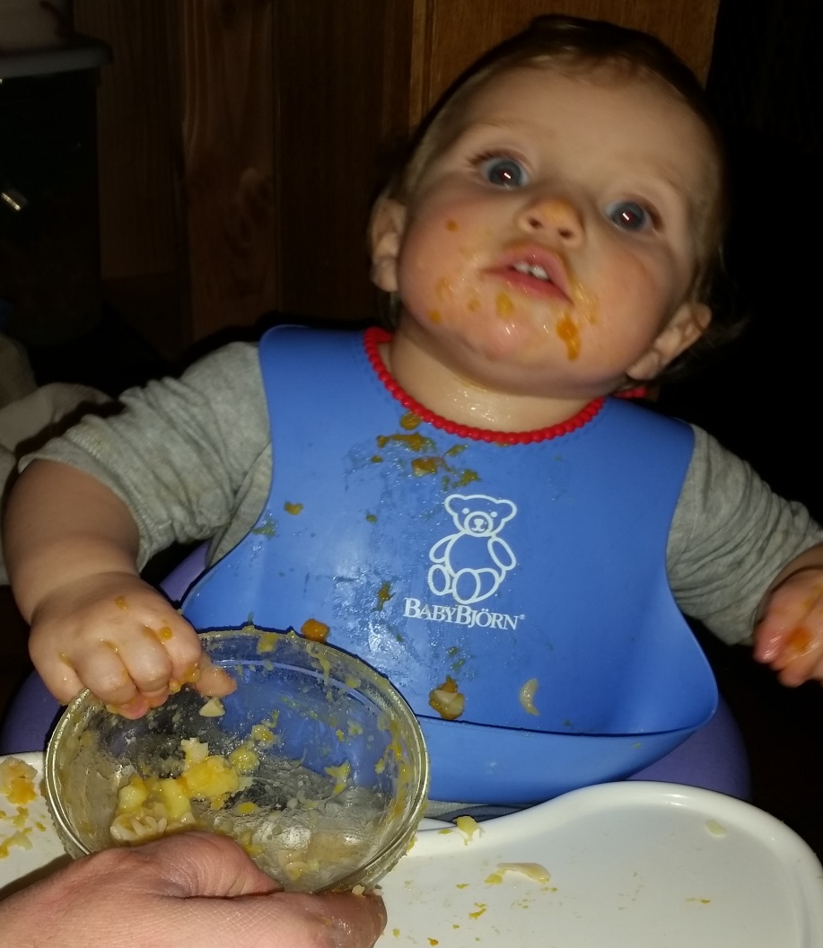
Visitation Plans
Assess - Learn - Practice - Demonstrate
-------------------------------------------------------------
  Quick to Start
  Include Siblings
  Alternative Contact
  Written Plan – Court Order
  Right of Family – Not Carrot-and-
  Stick
  Explain Supervision
    How will it progress?

Slide 16

Evaluating Success
Why Can’t Children Go Home Today?
Reduction of Threats? Emergence of New Threats?
Status of Protective Capacity?
Current Information for Answers?
Why Disputes? Challenge Parties to Resolve.
If no progress, why?
        Demand Information/Perspective of Parents

Slide 17
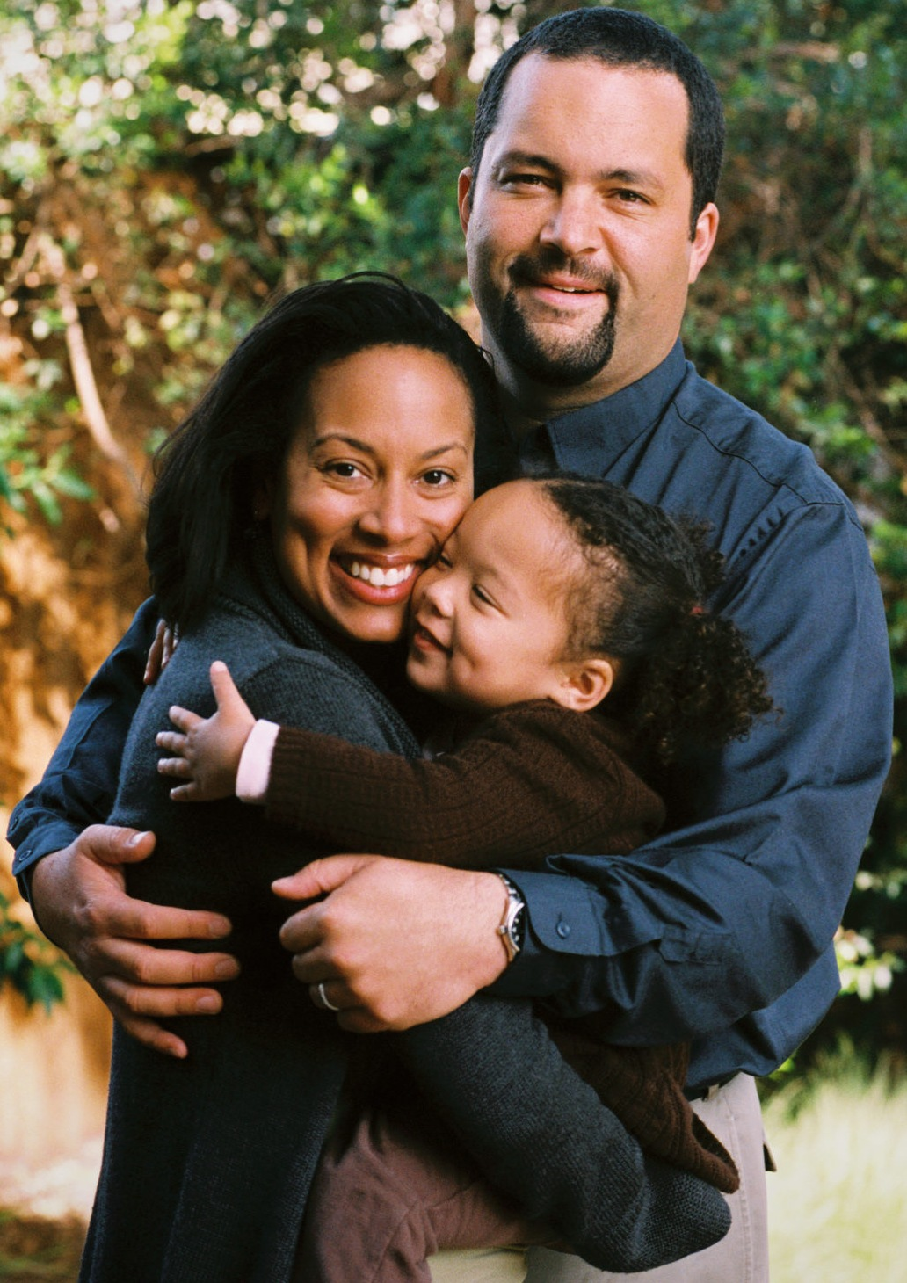
Reunification
Have conditions changed enough to support an In-Home Safety Plan?
  Sustainable:
  Can the plan be put into place? and can it work until it is no longer needed?
Observe visits
  Can unsupervised visits be happening now?
  Are any of the visits structured to provide information about the child-parent relationship
Parent Attitudes re: Threats and Protective Factors
Info from Treatment Providers
Notes:
Reunification
Changes to Safety discussion sufficient to create In-Home Plan?
Sustainable until parents can protect without help or oversight of the Court?
Evaluate Visits.
Should be Unsupervised by now.
Were they structured to provide information?
Parent Attitudes re: Threats and Protective Factors
Info from Treatment Providers
Preparation for Care Provider to Support Reunification?
Recommendation of Social Worker
Independent and Supported.
Reunification is a Plan, not an event.
"BenToddJealousFamily" by MyName (Imperfect chaosimperfect_chaos) - Own work. Licensed under CC BY-SA 3.0 via Wikimedia Commons - https://commons.wikimedia.org/wiki/File:BenToddJealousFamily.jpg#/media/File:BenToddJealousFamily.jpg

Slide 18
Reunification
Are We Preparing the Care Provider to Support Reunification?
Is the Recommendation of Social Worker Independent and Supported .
Reunification is a Plan, not an event.
Notes:
Reunification
Changes to Safety discussion sufficient to create In-Home Plan?
Sustainable until parents can protect without help or oversight of the Court?
Evaluate Visits.
Should be Unsupervised by now.
Were they structured to provide information?
Parent Attitudes re: Threats and Protective Factors
Info from Treatment Providers
Preparation for Care Provider to Support Reunification?
Recommendation of Social Worker
Independent and Supported.
Reunification is a Plan, not an event.
"BenToddJealousFamily" by MyName (Imperfect chaosimperfect_chaos) - Own work. Licensed under CC BY-SA 3.0 via Wikimedia Commons - https://commons.wikimedia.org/wiki/File:BenToddJealousFamily.jpg#/media/File:BenToddJealousFamily.jpg

Slide 19

Terminating Jurisdiction
Threats Eliminated
Protective Capacity Enhanced to Control Threats
Combination of Both
Notes:
Using Safety Criteria to Terminate Jurisdiction:
If you return and dismiss at the same time, either return was too late, or dismissal too early.
Keys:
Threats are eliminated
Protective Capacity is enhanced to control threats sustainably
Combination of both.
• Parent change, such as enhanced protective capacity, ongoing for a reasonable period of time;
• The parent can describe the change and explain how the change has produced benefits;
• The parent is taking active steps to sustain the change; and
• The child and parent are getting help from support services, members of their extended family, or others.
In order to comply with the use and licensing terms of this image, the following text must must be included with the image when published in any medium, failure to do so constitutes a violation of the licensing terms and copyright infringement: © Tomas Castelazo, www.tomascastelazo.com / Wikimedia Commons, via Wikimedia Commons

Slide 20
Evolve Leadership
to Promote Justice
in Child Welfare
Robert Wyman
D’Adre Cunningham
Notes:
Encourage local dependency courts and the various agencies and organizations that work in them to develop the capacity to solve complex problems.
Continuous improvement – helping court systems adapt to changing circumstances

